Slide 1


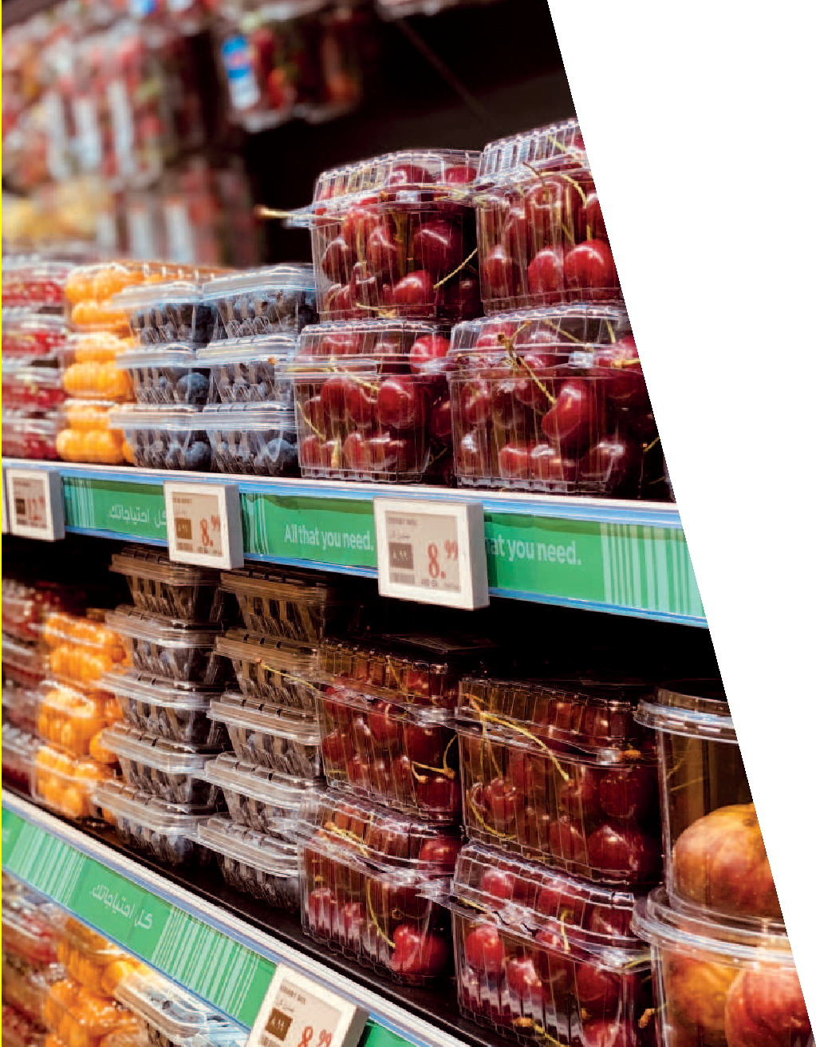
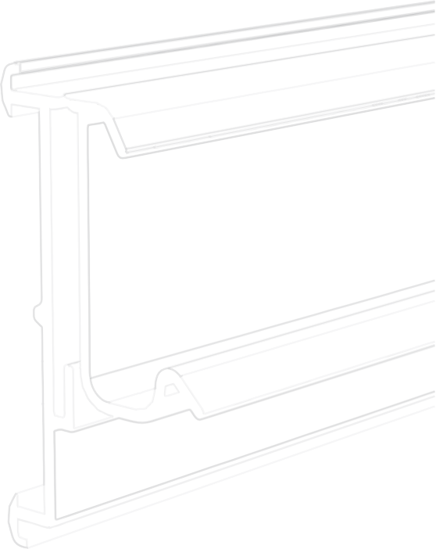
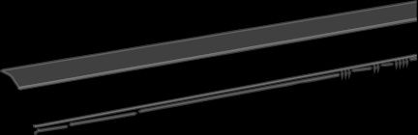
SHELF
For “NEWTON” electronic labels
This catalog has been segmented according to the types of shelves, the special METRO / MAKRO range, accessories for profiles and Stripe LCD.
PROFILES
CATALOGUE
20
23

Slide 2

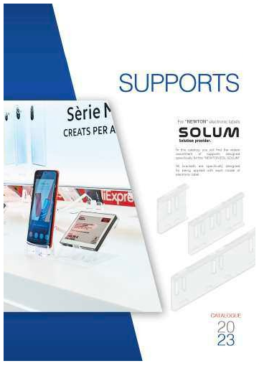
Profiles for electronic labels Solum / Catalogue 2023
In this catalog you will find the widest assortment of profiles for the different types of shelves on the market.
If the profile you need is not in this catalog, we can develop it in a short period of time.
We keep a permanent stock of all referenced models in 985 and 1315 mm lengths and in transparent and black colors.
CATALOGUES
See our catalogs of “accessories” and “supports” where you will find the widest assortment of designed items specifically for solum newton electronic labels.
All our profiles are one-piece, that is, they are inserted directly into the front of the shelving without the need for assemblies or other manipulations.
To facilitate the search for the right profile for the shelf model in your store, this catalog has been segmented according to the types of shelves, the special METRO / MAKRO range, accessories for profiles and Stripe LCD.
ACCESORIES
In this catalog you will find the widest assortment of ACCESSORIES
compatible with the supports and boxes designed for the “NEWTON ESL SOLUM”.
These accessories will allow you, among other things, to vary the height and inclination when implanting your labels, fasten them on wooden, metal or glass shelves, fix them in baskets, boxes or on edges of any thickness, and hang them on tubes and rods, among others. Applications. For large format labels, you can hang them on suspended profiles, place them on telescopic tubes or fix them with magnets on metal surfaces.
PAGE
INDEX
EXTRUSION PROFILES
FOR NEWTON ELECTRONIC LABELS
04
TO 13
Standard series profiles
PEE 1100 / 1150 / 1175 / 1155 / 1330 /
1225 / 1325 / 1200 / 1450 / 1250 /
1275 / 1300 / 1400 / 1425 / 1375 /
1125 / 1350 / 1318 / 1180 / 1185 /
1290 / 1295 / 1430 / 1370 / 2300/
1380
The perfect combination of accessories with injection parts guarantees that there will be no product in your store where you cannot mark its price with SOLUM electronic labels.
If the accessory you need is not in this chapter, please consult us and we will develop it in a short space of time.
14
TO 17
Makro/metro series profiles
SUPPORTS
In this catalog you will find the widest assortment of supports designed specifically for the “NEWTON ESL SOLUM”.
PEE 2000 / 2050 / 2075 / 2100 / 2025 /
2125 / 2150
All holders are specifically designed for your application with each electronic tag model.
18
TO 18
Accesories for profiles
Most have inserts that, in combination with our accessories, allow each label model to be displayed in different positions to adapt to any type of furniture and surface, adapting to any situation that you need in your store.
19
TO 21
Promo system
In cases where these supports come into contact with food, the materials with which they have been manufactured are special for food use.
If you do not find the support you need, contact us and we will develop it in the shortest possible time.
2 https://ovelar-retail.com
3

Slide 3
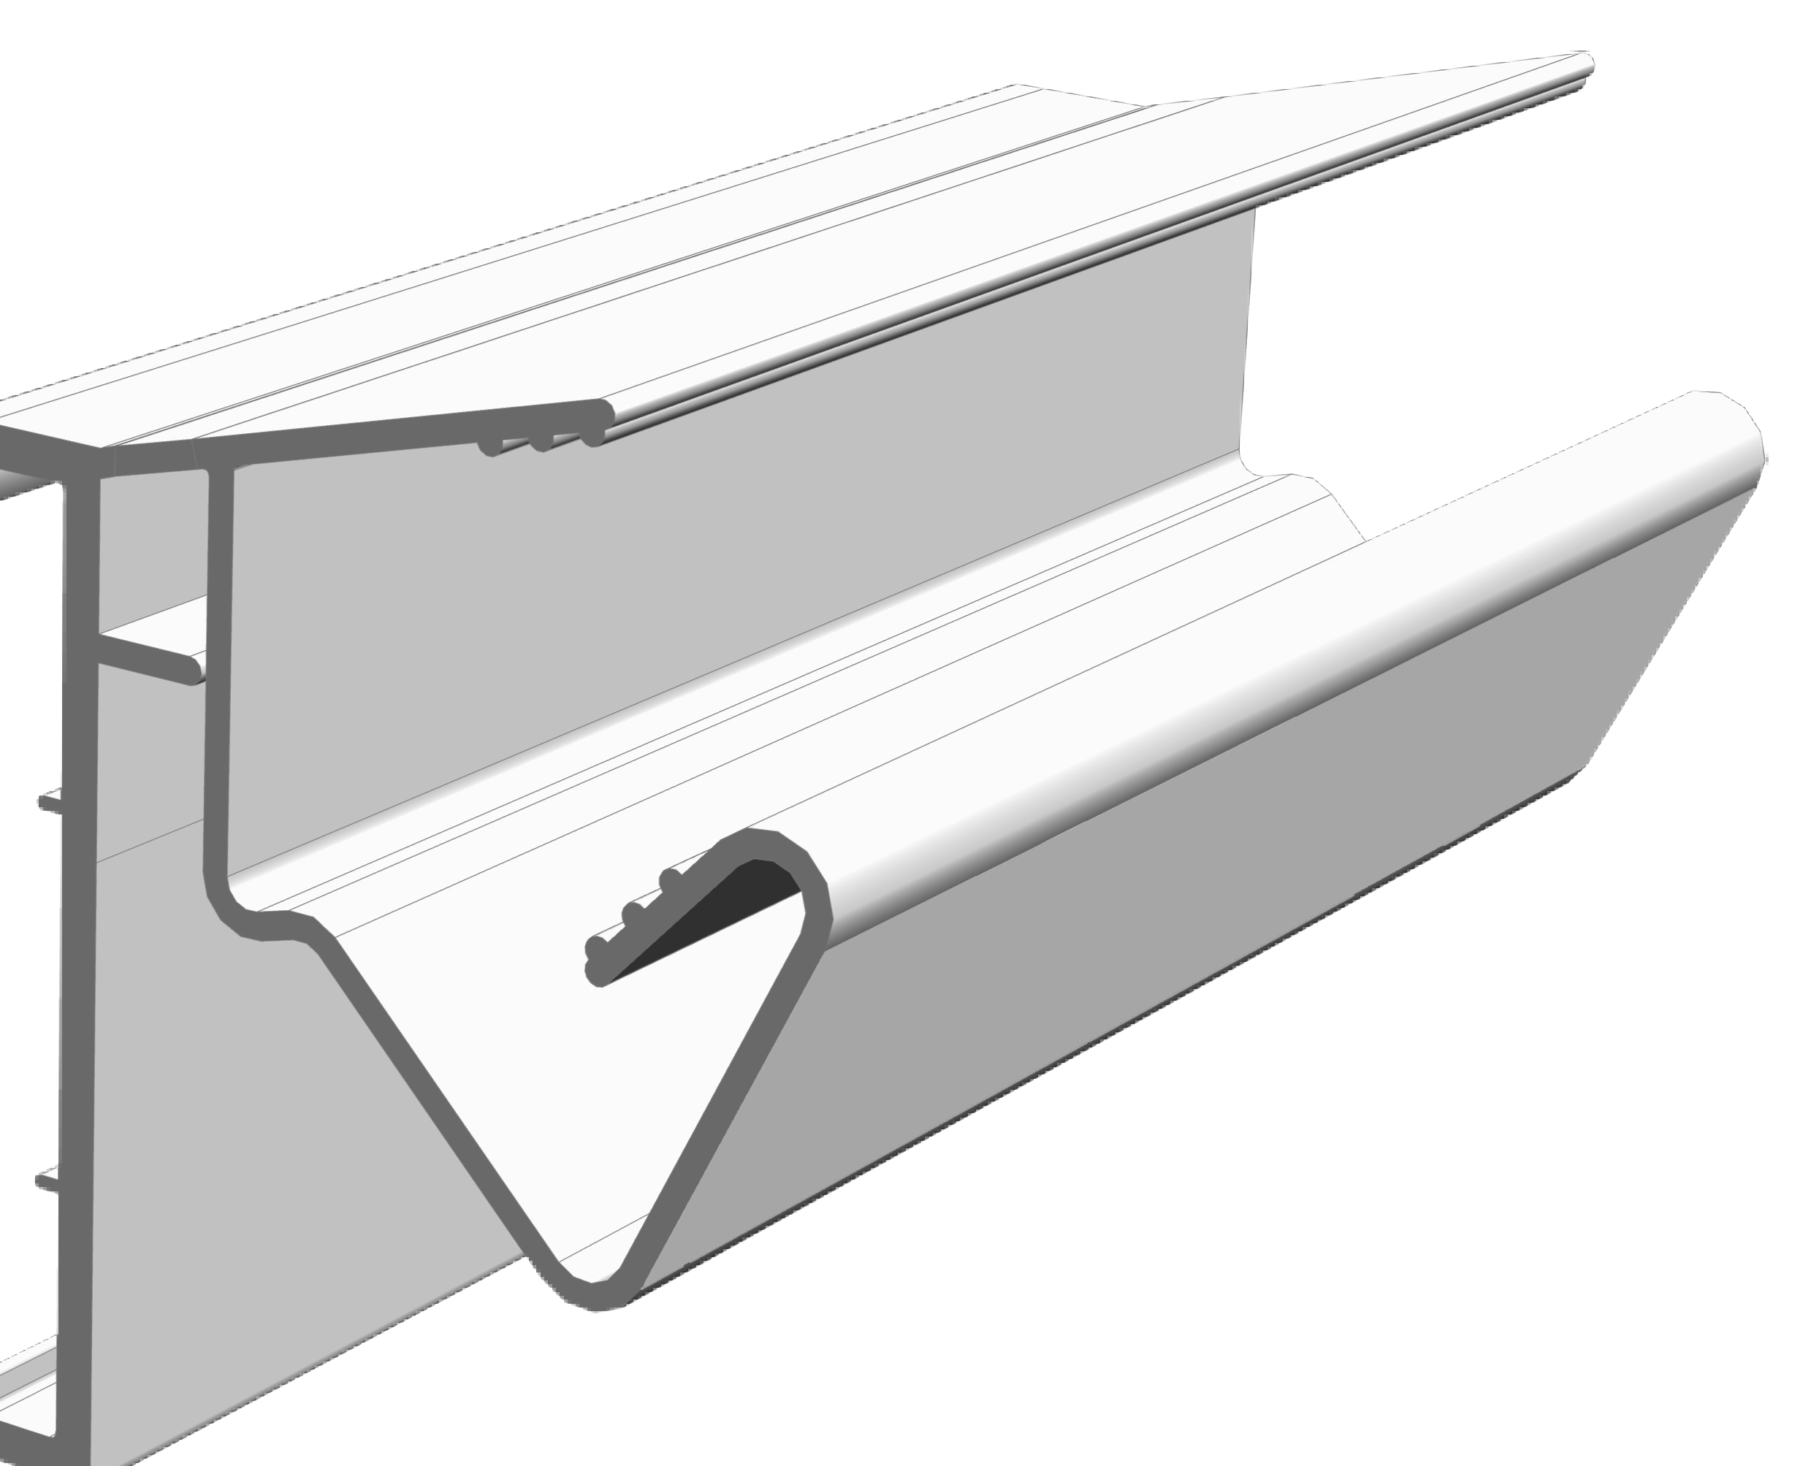
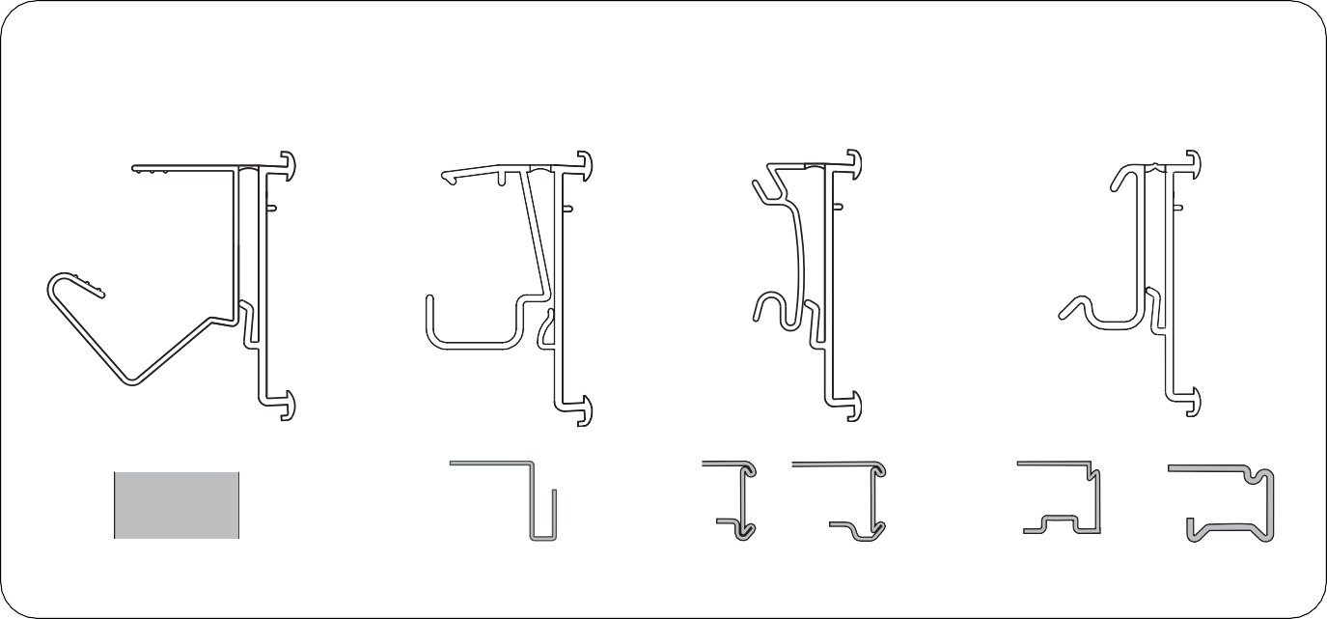
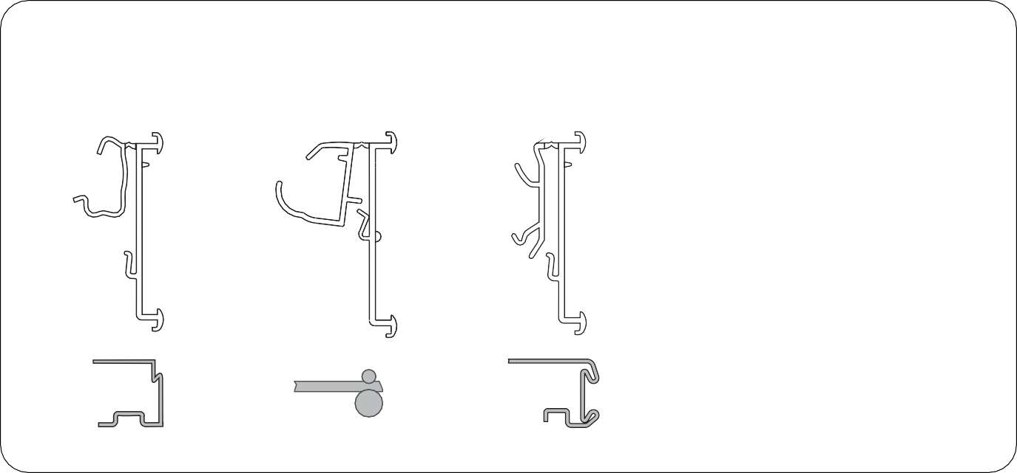

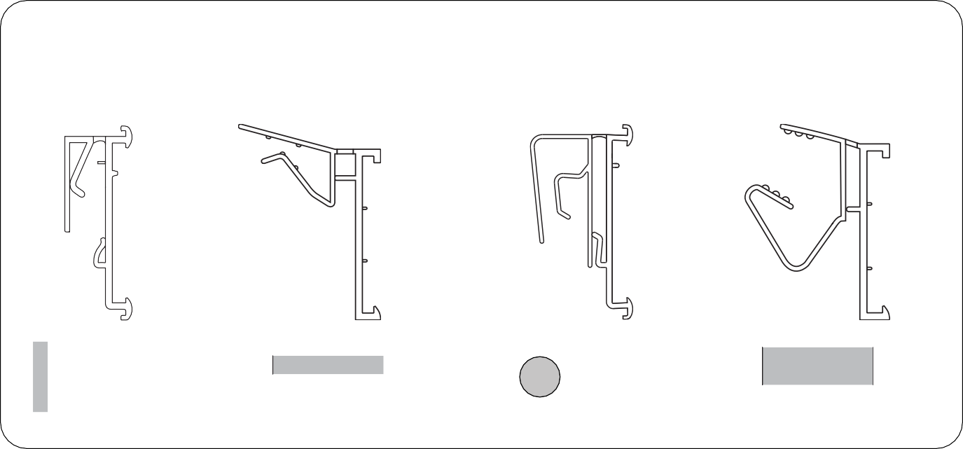
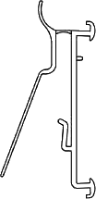


Profiles for electronic labels Solum / Catalogue 2023
Page 9
Profiles for wooden shelves
PEE 1450 PEE 1250
Profiles for commercial shelves
PEE 1275 PEE 1300
STANDARD
SERIES PROFILES
WOODEN SHELVES FROM 16 TO 28 mm
MDT / SAURINA
HMY
ALSER INNOVATION V4
CEFLA S25 MODERN EXPO KIDER KS
CAEM T25
Page 7
Page 10
Profiles for flat shelves or surfaces
PEE 1100 PEE 1150
Balda profile 30º
Profiles for commercial shelves
PEE 1400 PEE 1425
PEE 1175
PEE 1155
PEE 1375
PEE 1125
CEFLA SYSTEM 10
WANZL
INTRAC IMZ25
STOREBEST
TEGOMETALL LINDE / COSTAN
Page 8
Page 11
Edge profile
Profile for glass shelf
Profile for rods
Profiles for wooden shelves
Profiles for commercial shelves
PEE 1330
PEE 1225
PEE 1325
PEE 1200
PEE 1350
PEE 1318
PEE 1180
PEE 1185
EDGES
ROM 1 TO 3 mm
GLASS SHELVES FROM 6 TO 8 mm
DIAMETER UP TO 8 mm
WOODEN SHELVES FROM 12 TO 16 mm
32
BONET NÈVÈ
LINDE / COSTAN
AFS SYSTEM 20
SIDAC
INTRAC - ARNEG AMX35
4
5

Slide 4
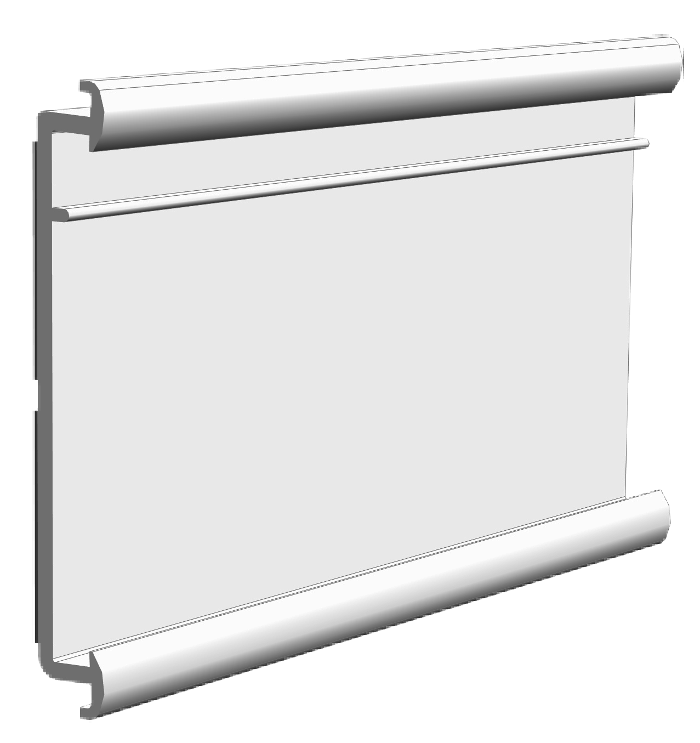

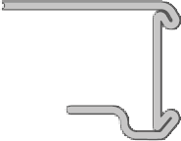
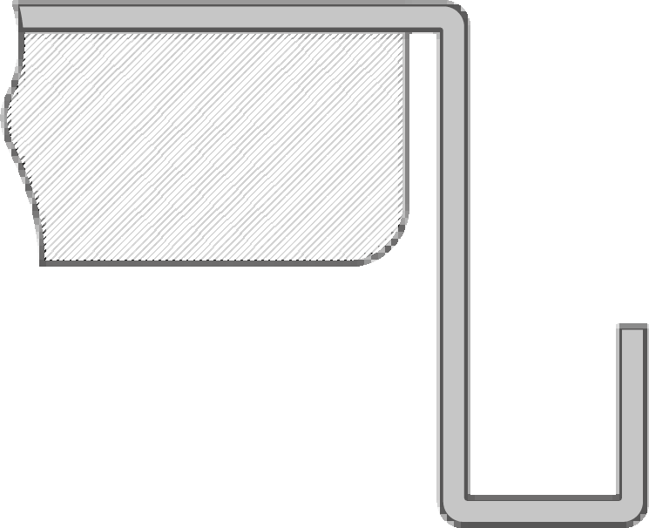
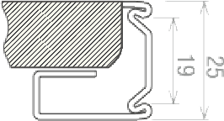
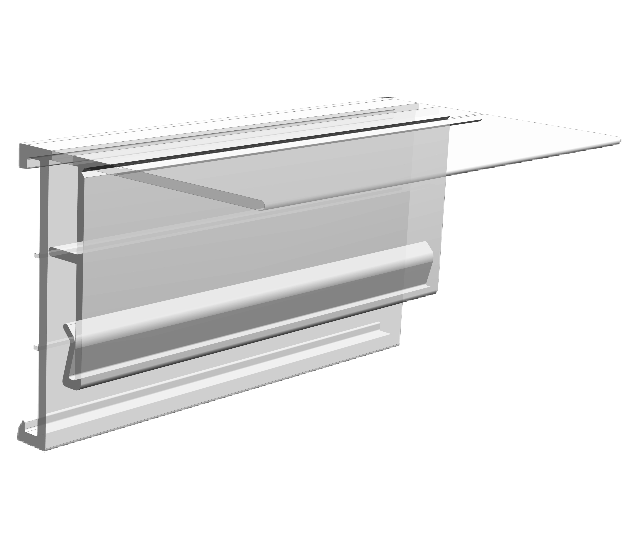


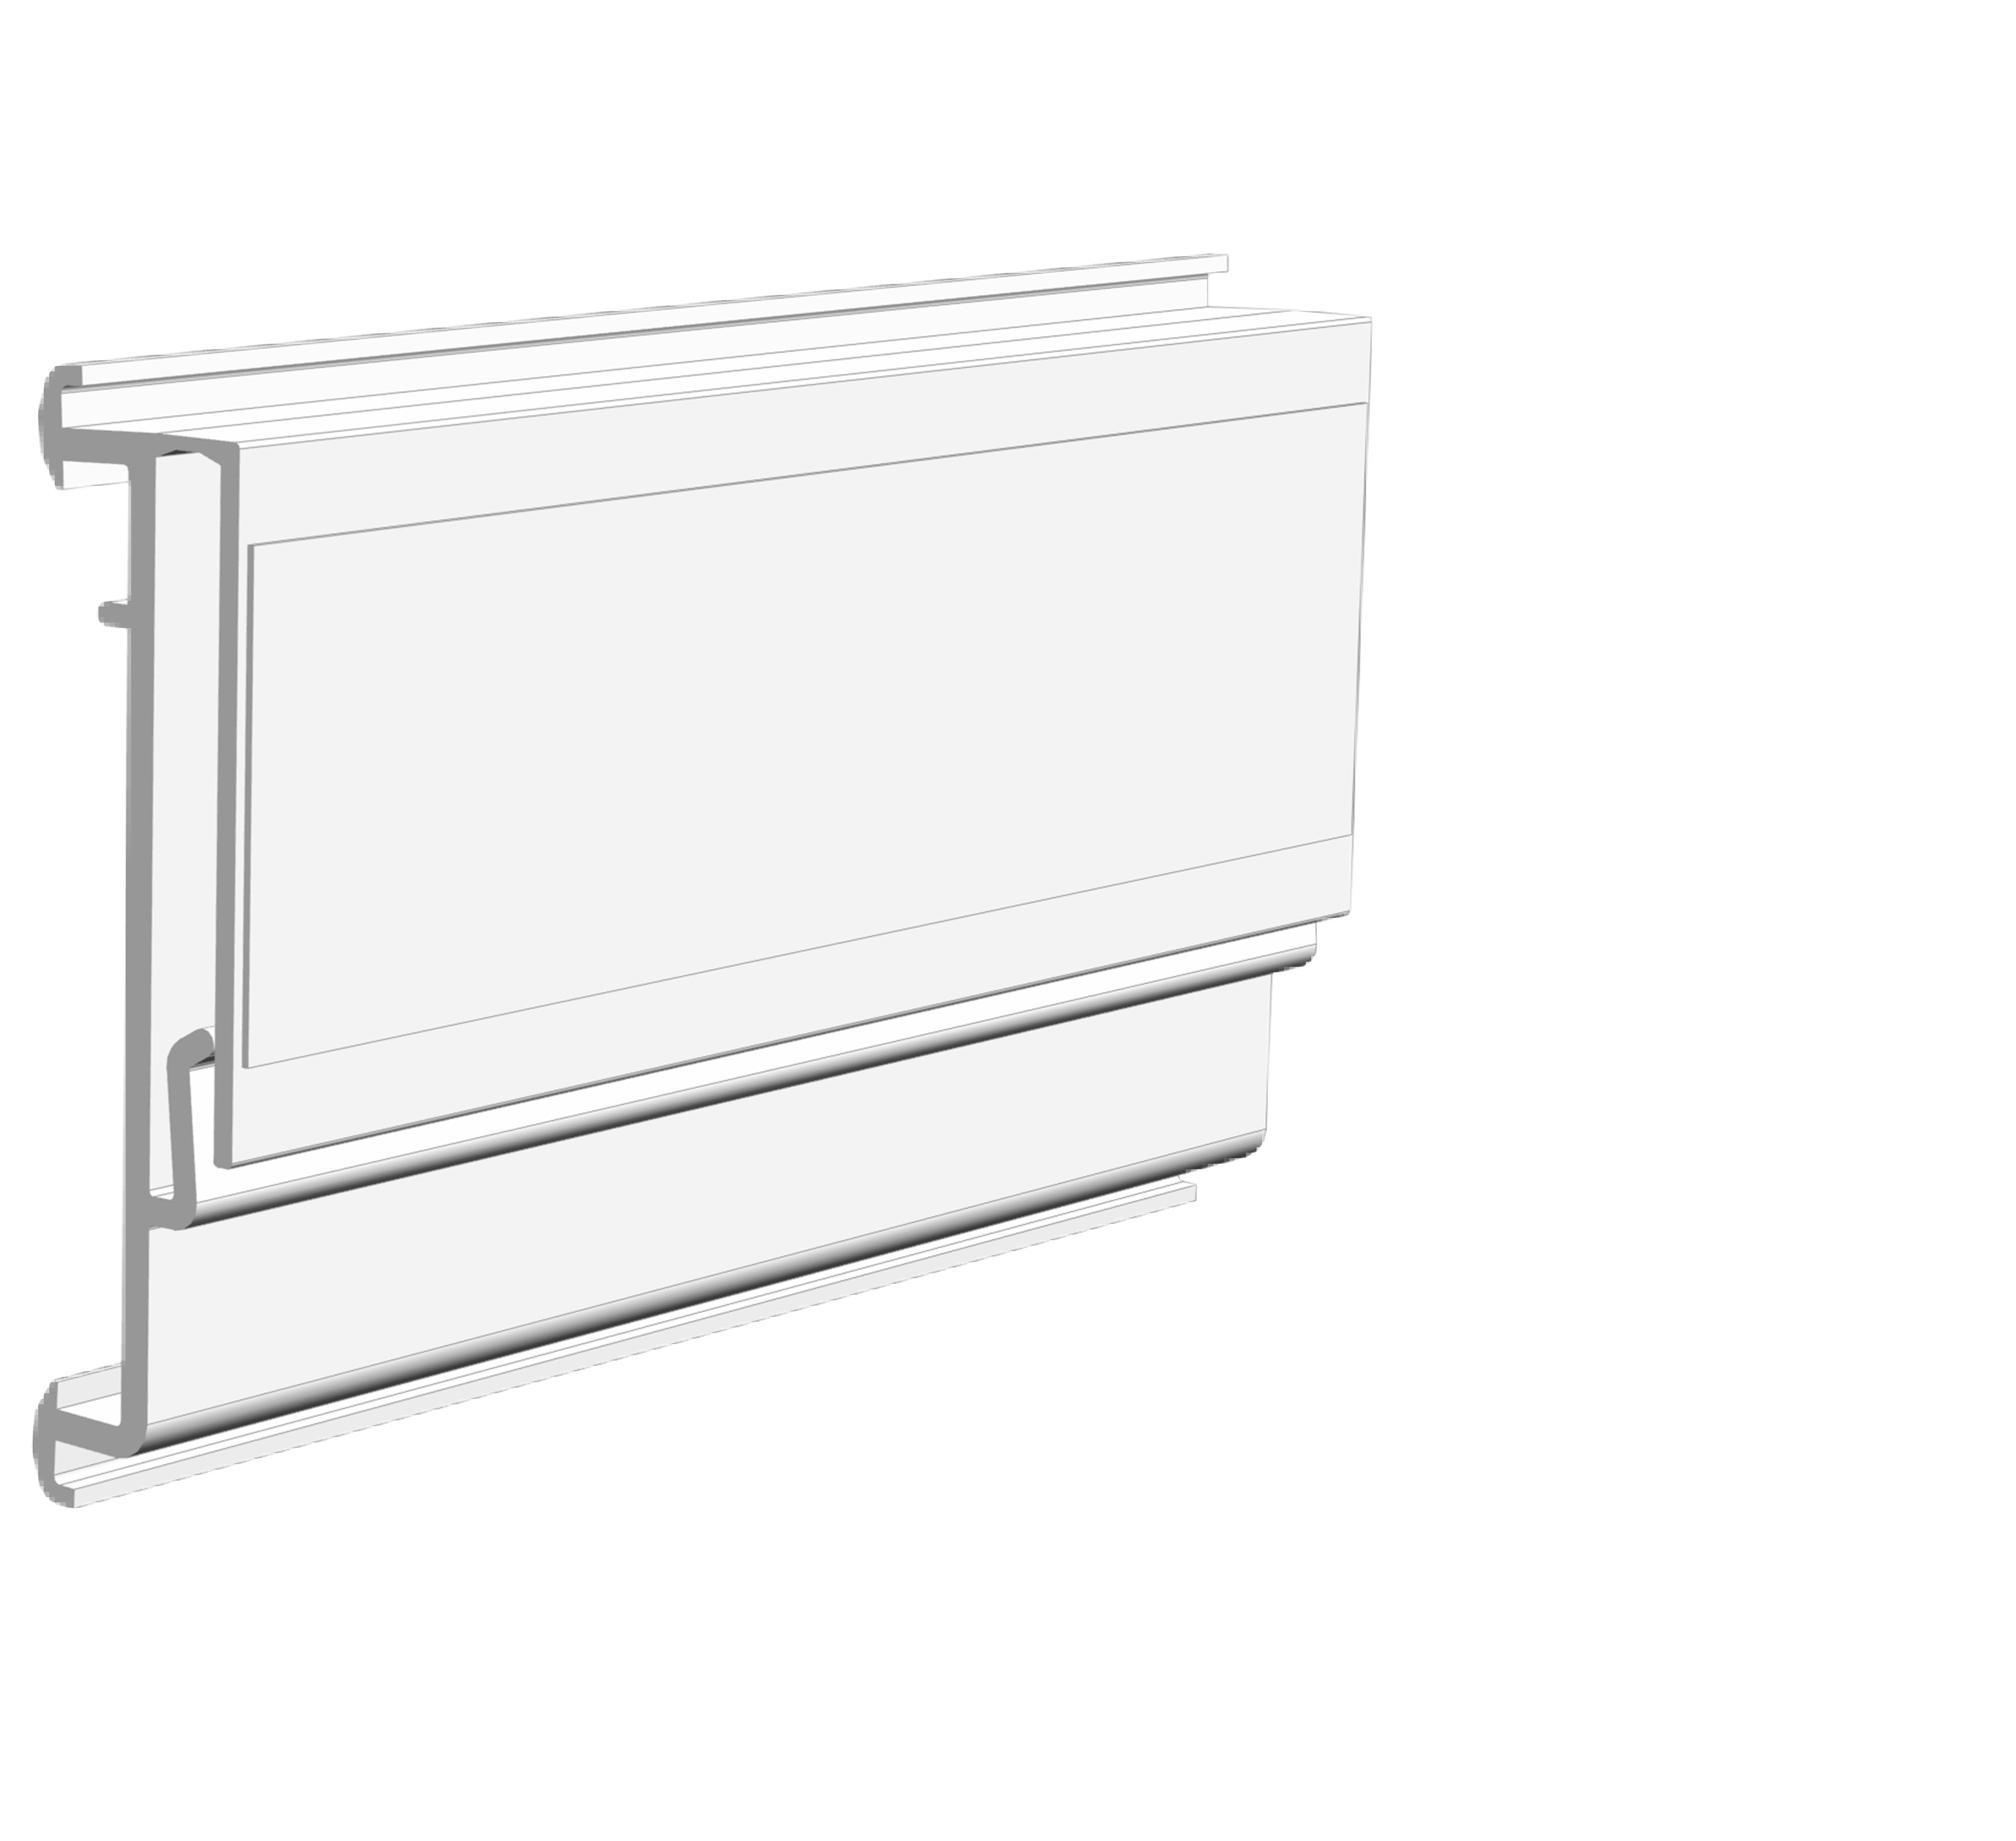
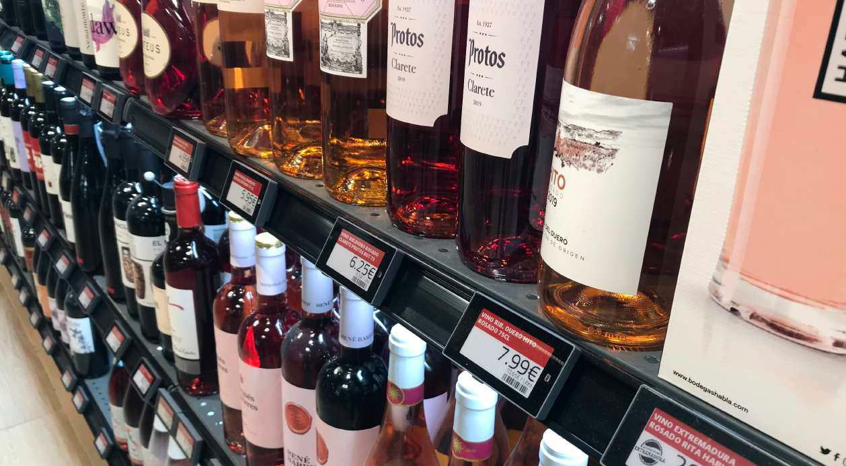
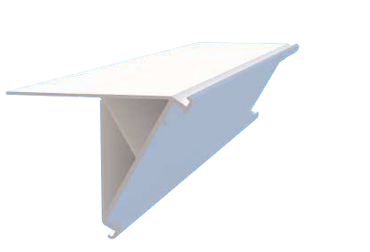
Profiles for electronic labels Solum / Catalogue 2023
Page 12
PEE 1100
Profile for shelves or surfaces with flat front
Profiles for commercial shelves
PEE 1290 PEE 1295
ZAF profiles
PEE 1430
PEE 1380
CODE
COLOR
PEE 1100-00 | TRANSPARENT
PEE 1100-05 | BLACK
SHELF SECTION
(Other Colors upon request)
Lenghts in stock: 985 & 1315 mm
(Other lenghts upon request)
Order quantity: Box of 50 pcs
PEE 1150
Profile with adhesive and double flap. With double adhsive and hinge for oscilating function
CODE COLOR
ARNEG OXACA
LA FORTEZZA F25
ZAF (OLD VERSION)
INTRAC IMZ25
Page 13
PEE 1150-00 | TRANSPARENT
PEE 1150-05 | BLACK
Bumper profiles
SHELF SECTION
(Other Colors upon request)
PEE 1370
PEE 2300
Lenghts in stock: 985 & 1315 mm
(Other lenghts upon request)
Order quantity: Box of 40 pcs
PEE 1175
Profile with adhesive flap With double adhsive and hinge for oscilating function
Bumper profiles for lower shelves.
Applicable to all types of commercial shelves.
CODE
COLOR
PEE 1175-00 | TRANSPARENT
PEE 1175-05 | BLACK
SHELF SECTION
(Other Colors upon request)
Lenghts in stock: 985 & 1315 mm
(Other lenghts upon request)
Order quantity: Box of 50 pcs
PEE 1155
Balda profile 30º
CODE
COLOR
PEE 1155-00 | TRANSPARENT
PEE 1155-05 | BLACK
SHELF SECTION
(Other Colors upon request)
Lenghts in stock: 985 & 1315 mm
(Other lenghts upon request)
Order quantity: Box of 40 pcs
7

Slide 5
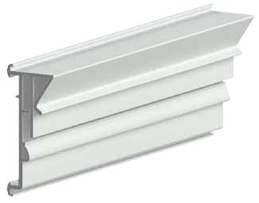
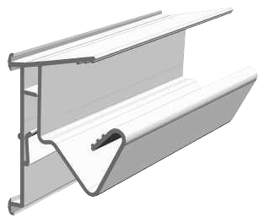
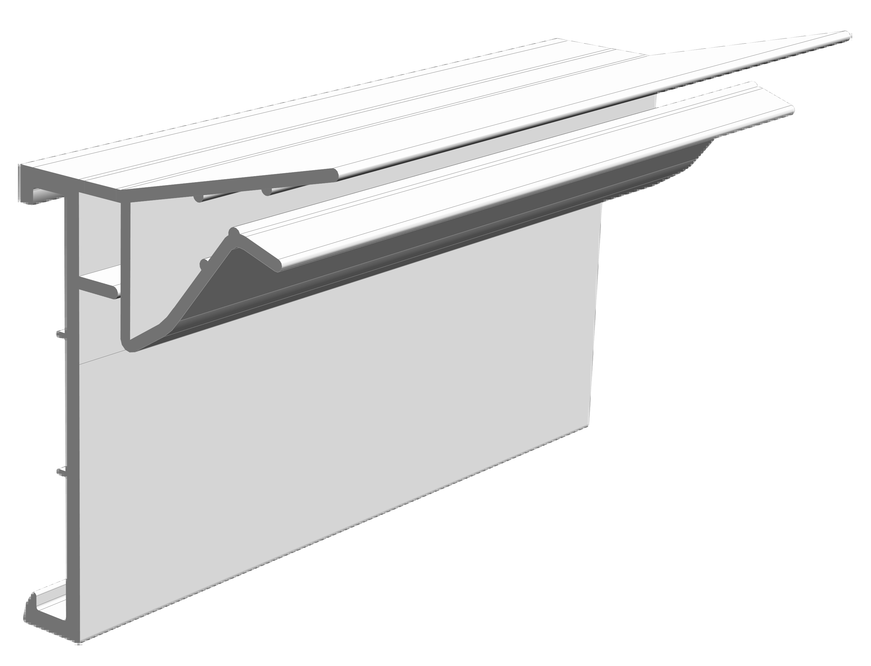
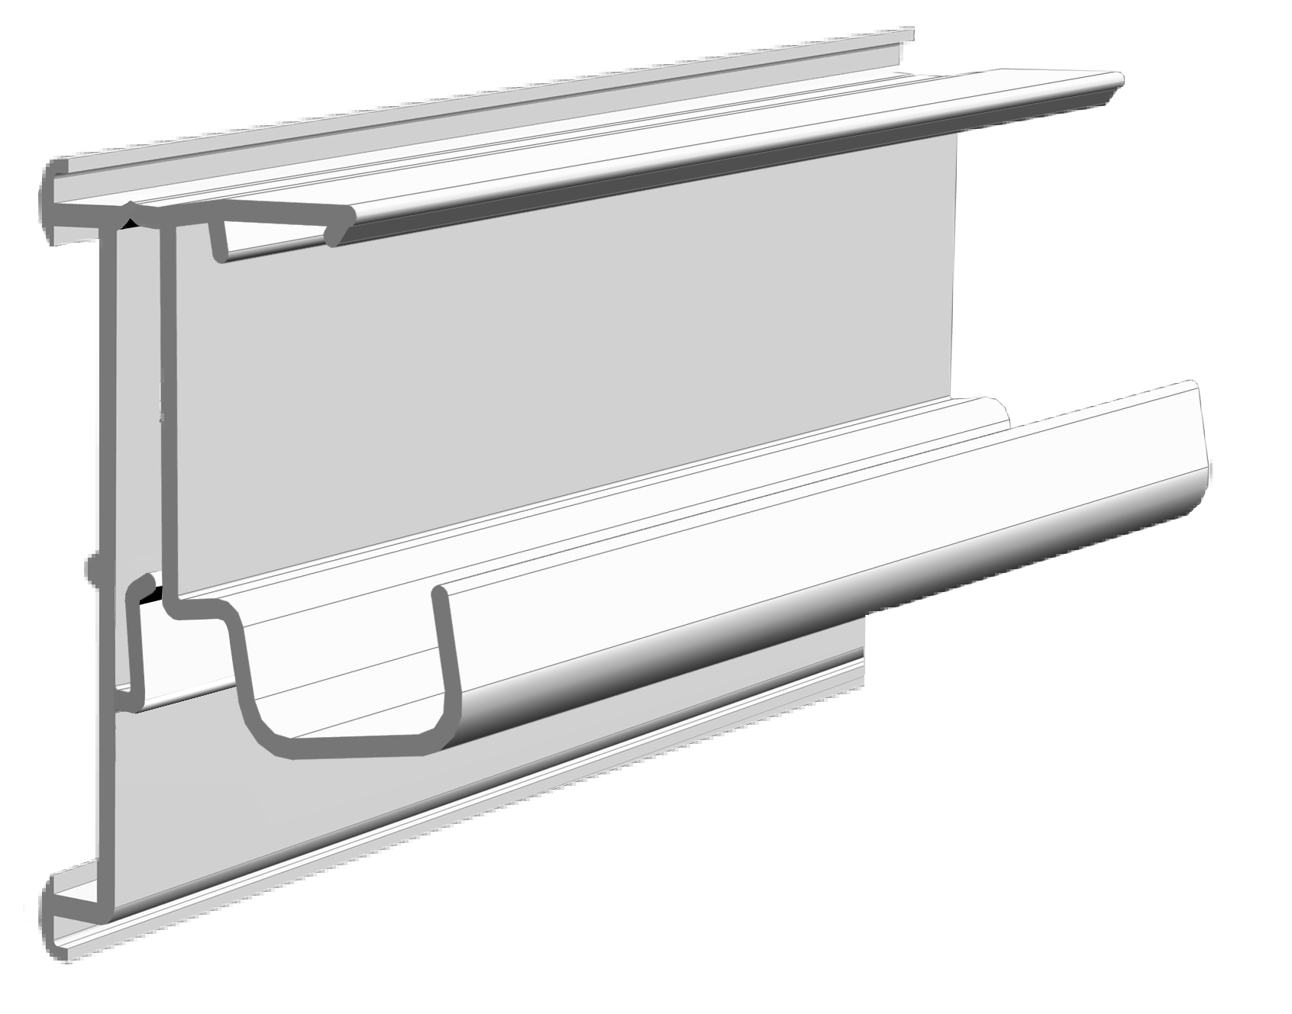
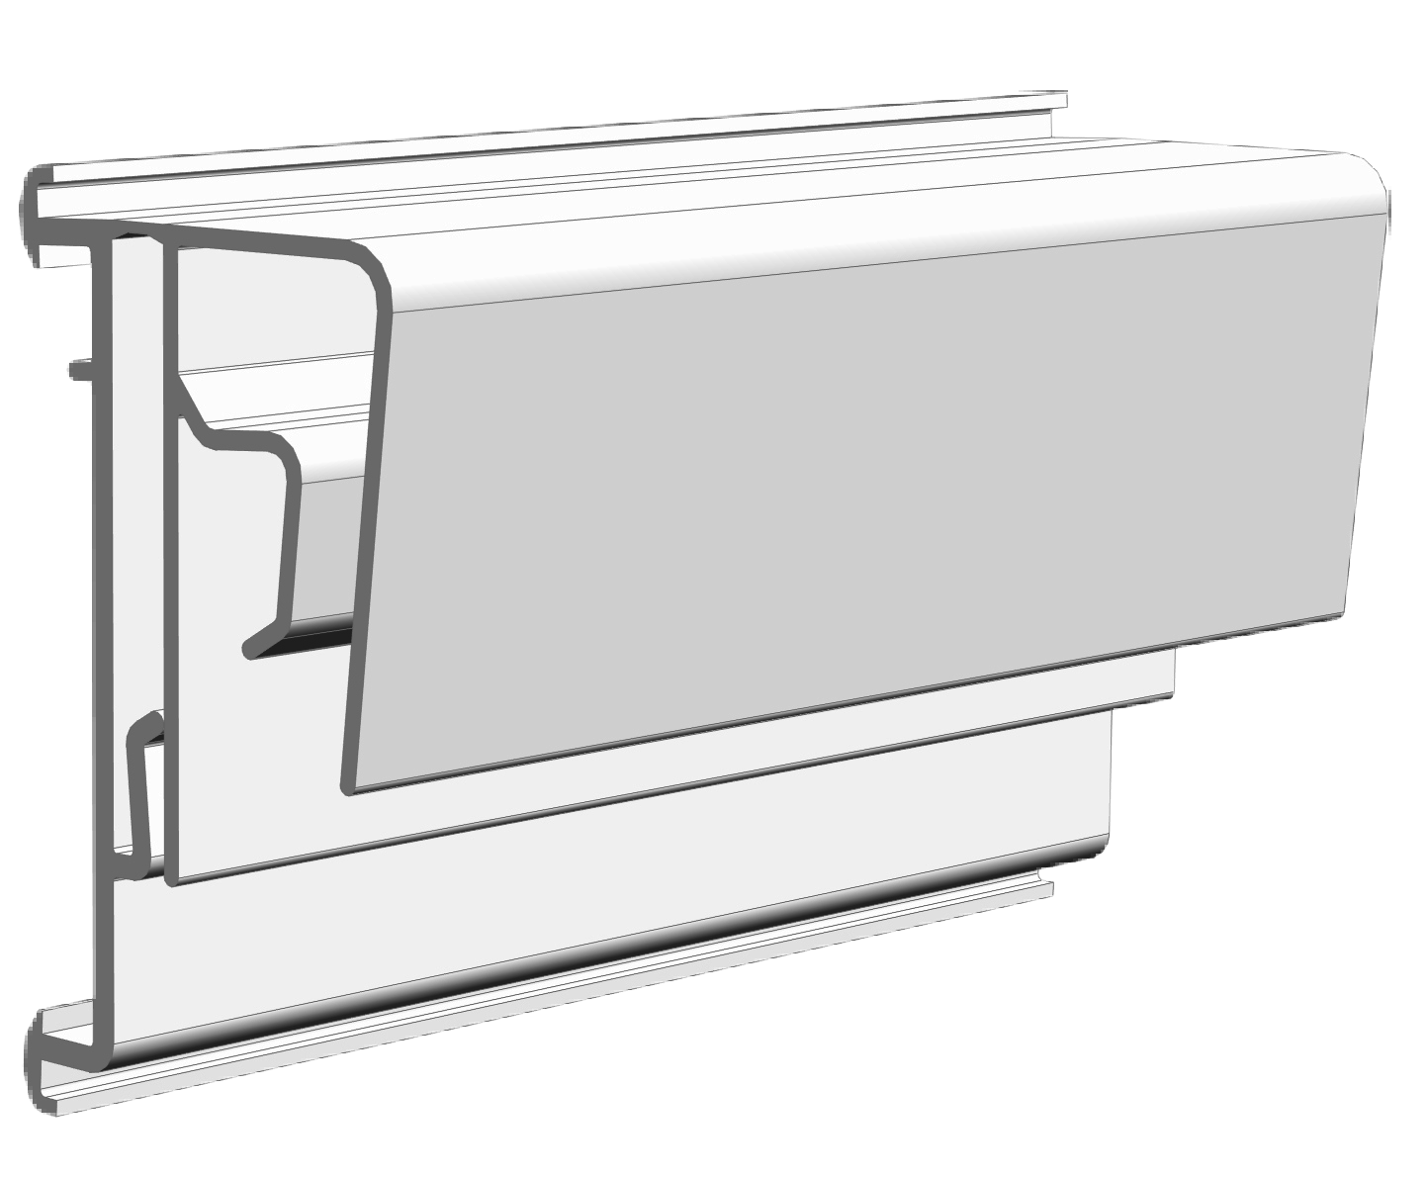
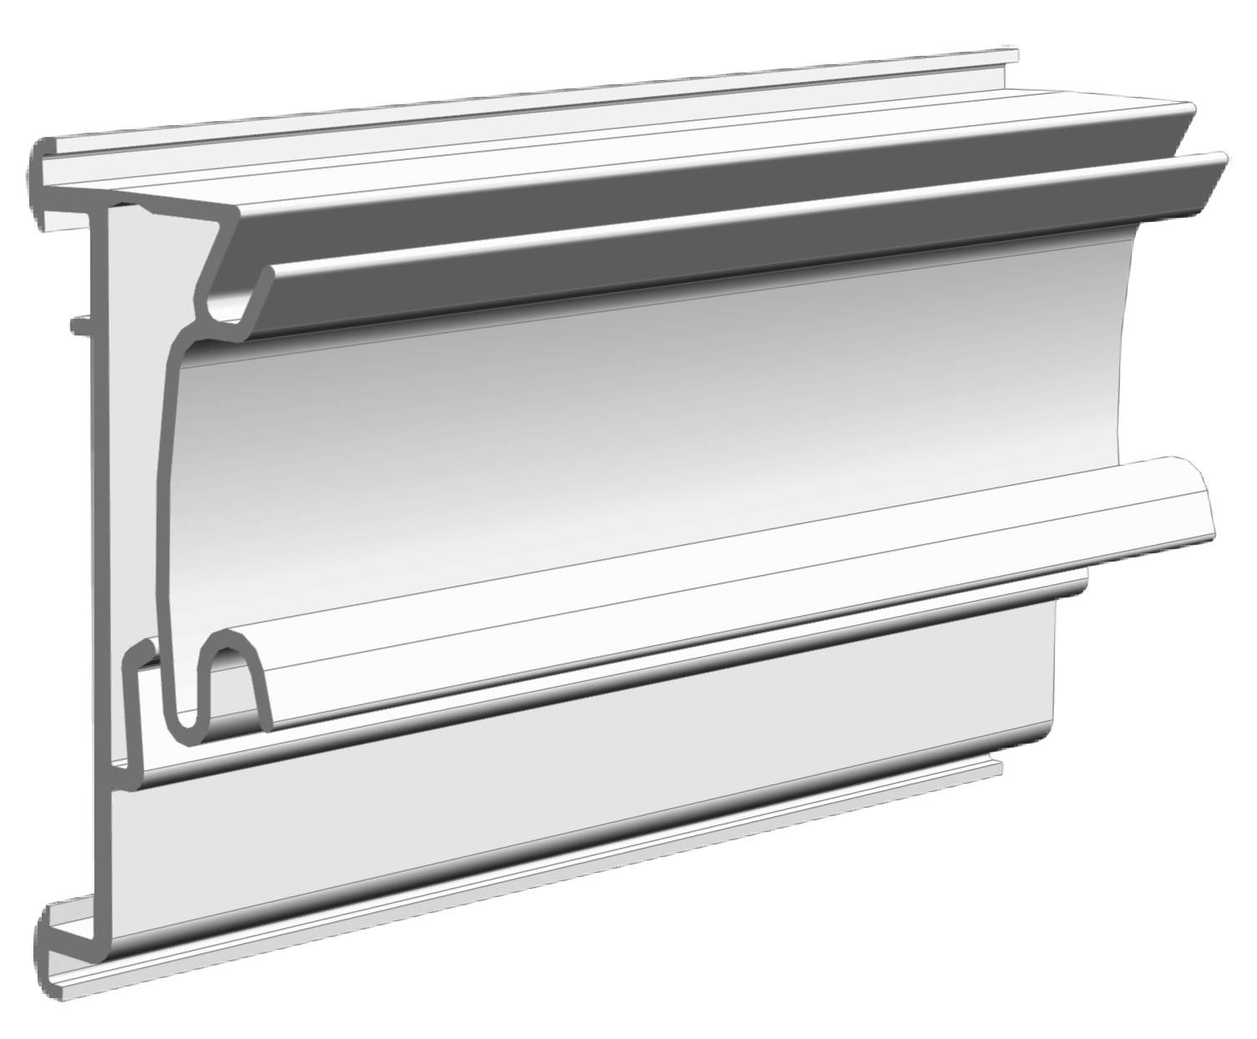
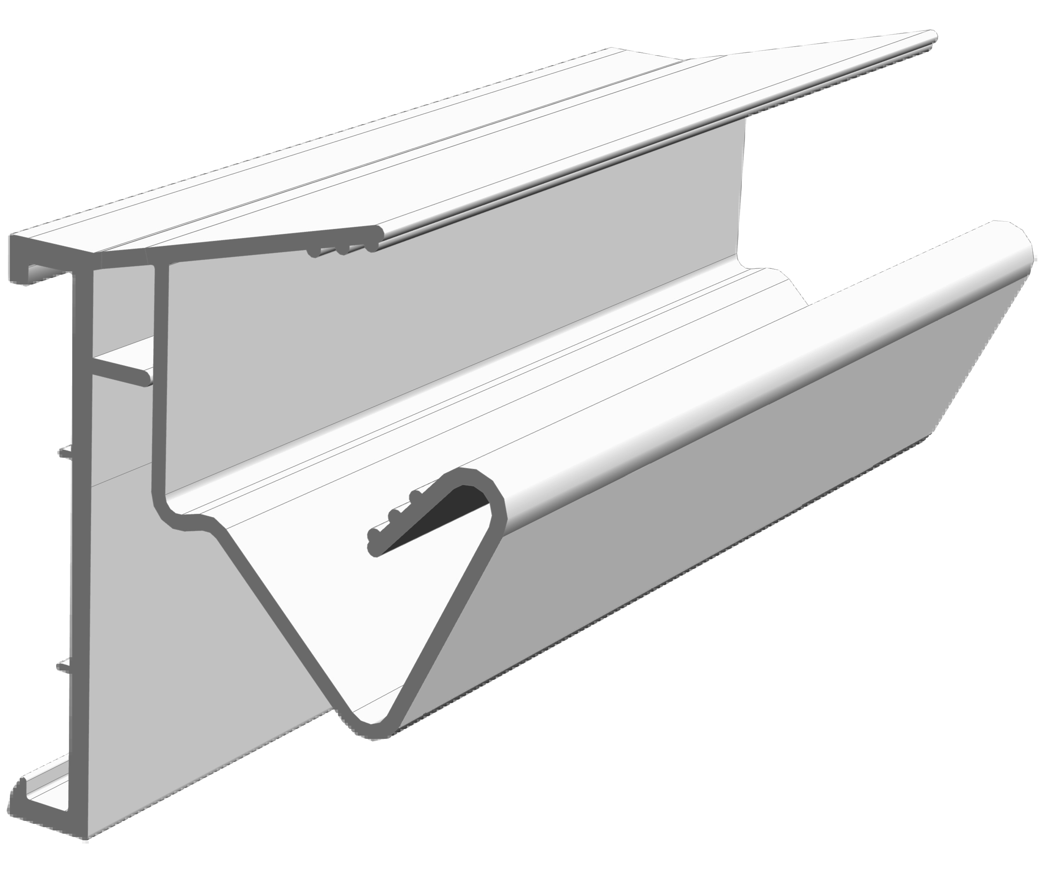
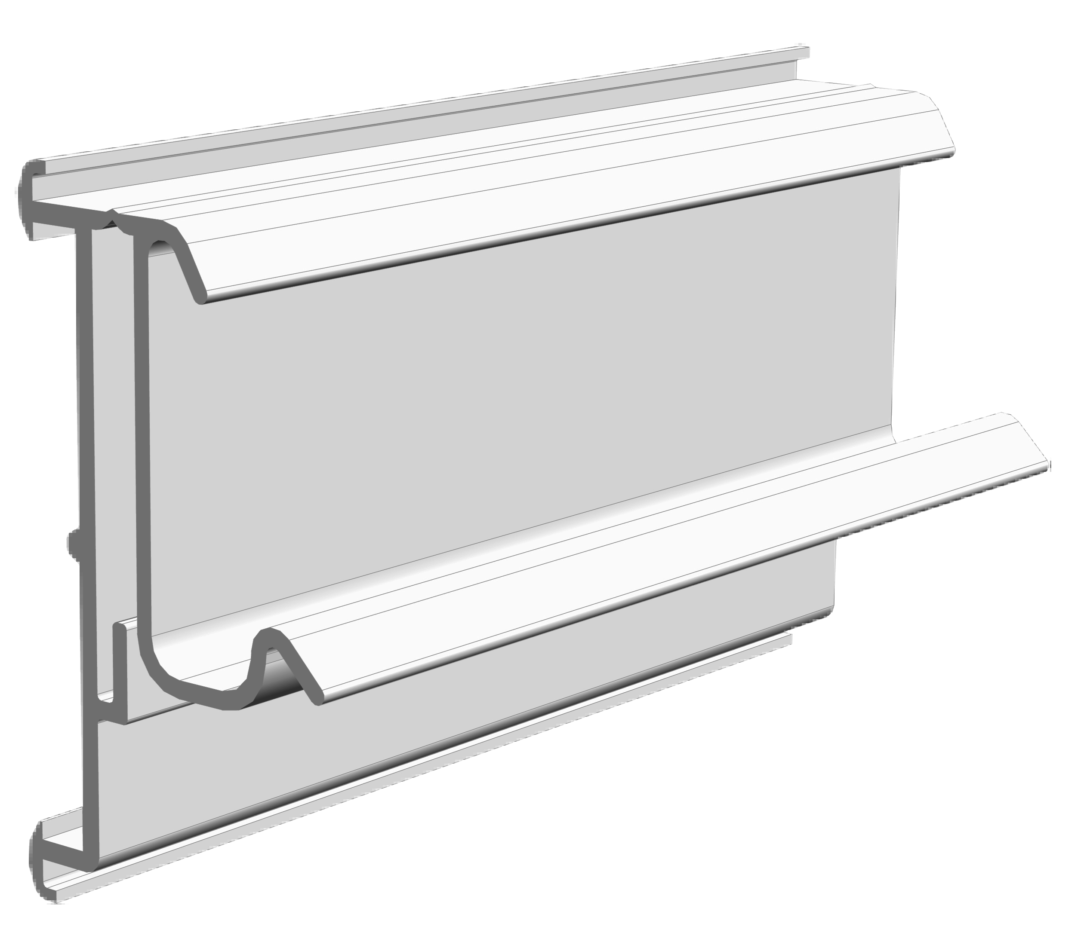
Profiles for electronic labels Solum / Catalogue 2023
PEE 1330
Profile for edges from 1 to 3 mm. With hinge for oscilating function
PEE 1450
Profile for wooden shelves from 16 to 28 mm thickness. With hinge for oscilating function.
CODE COLOR
CODE
COLOR
PEE 1450-00 | TRANSPARENT
PEE 1450-05 | BLACK
PEE 1330-00 | TRANSPARENT
PEE 1330-05 | BLACK
SHELF SECTION
SHELF SECTION
(Other Colors upon request)
16<28 mm
1<3 mm
Lenghts in stock: 985 & 1315 mm
(Other lenghts up on request)
Order quantity: 50u.
Lenghts in stock: 985 & 1315 mm
(Other lenghts upon request)
Order quantity: Box of 25 pcs
PEE 1225
Profile for glass shelves from 6 to 8mm thickness. With hinge for oscilating function.
PEE 1250
Profile for SAURINA/MDT shelves. With hinge for oscilating function.
CODE
COLOR
CODE
COLOR
PEE 1225-00 | TRANSPARENT
PEE 1225-05 | BLACK
SHELF SECTION
PEE 1250-00 | TRANSPARENT
PEE 1250-05 | BLACK
(Other Colors upon request)
(Other Colors upon request)
SHELF SECTION
Lenghts in stock: 985 & 1315 mm
(Other lenghts upon request)
Order quantity: Box of 25 pcs
SAURINA/MDT
Lenghts in stock: 985 & 1315 mm
(Other lenghts upon request)
Order quantity: Box of 25 pcs
6 < 8mm
PEE 1325
Profile for wire baskets up to 8 mm diameter. With hinge for oscilating function.
PEE 1275
Profile for HMY P-25 & ALSER INNOVATION V4 shelves. With hinge for oscilating function.
CODE COLOR
CODE
COLOR
PEE 1275-00 | TRANSPARENT
PEE 1275-05 | BLACK
PEE 1325-00 | TRANSPARENT
PEE 1325-05 | BLACK
SHELF SECTION
SHELF SECTION
(Other Colors upon request)
(Other Colors upon request)
Lenghts in stock: 985 & 1315 mm
(Other lenghts upon request)
Order quantity: Box of 50 pcs
HMY
ALSER INNOVATION V4
Lenghts in stock: 985 & 1315 mm
(Other lenghts upon request)
Order quantity: Box of 50 pcs
DIAMETER UP TO 8 mm
PEE 1200
Profile for wooden shelves from 12 to 16 mm thickness. With hinge for oscilating function.
PEE 1300
Profile for MODERN EXPO, CEFLA SYSTEM 25, KIDER KS & CAEM T25 shelves. With hinge for oscilating function
CODE
CODE
COLOR
COLOR
PEE 1200-00 | TRANSPARENT
PEE 1200-05 | BLACK
PEE 1300-00 | TRANSPARENT
PEE 1300-05 | BLACK
(Other Colors upon request)
SHELF SECTION
SHELF SECTION
(Other Colors upon request)
12<16 mm
Lenghts in stock: 985 & 1315 mm
(Other lenghts upon request)
Order quantity: Box of 25 pcs
KIDER KS CEFLA S25 MODERN EXPO
CAEM T25
Lenghts in stock: 985 & 1315 mm
(Other lenghts upon request)
Order quantity: Box of 40 pcs
8
9

Slide 6
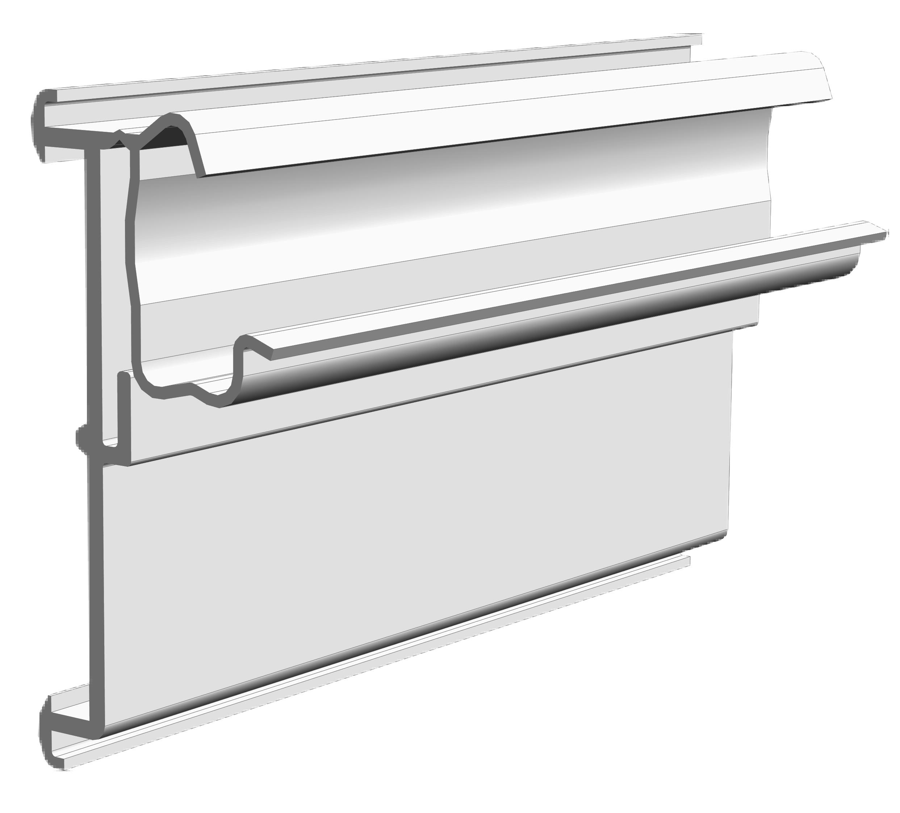
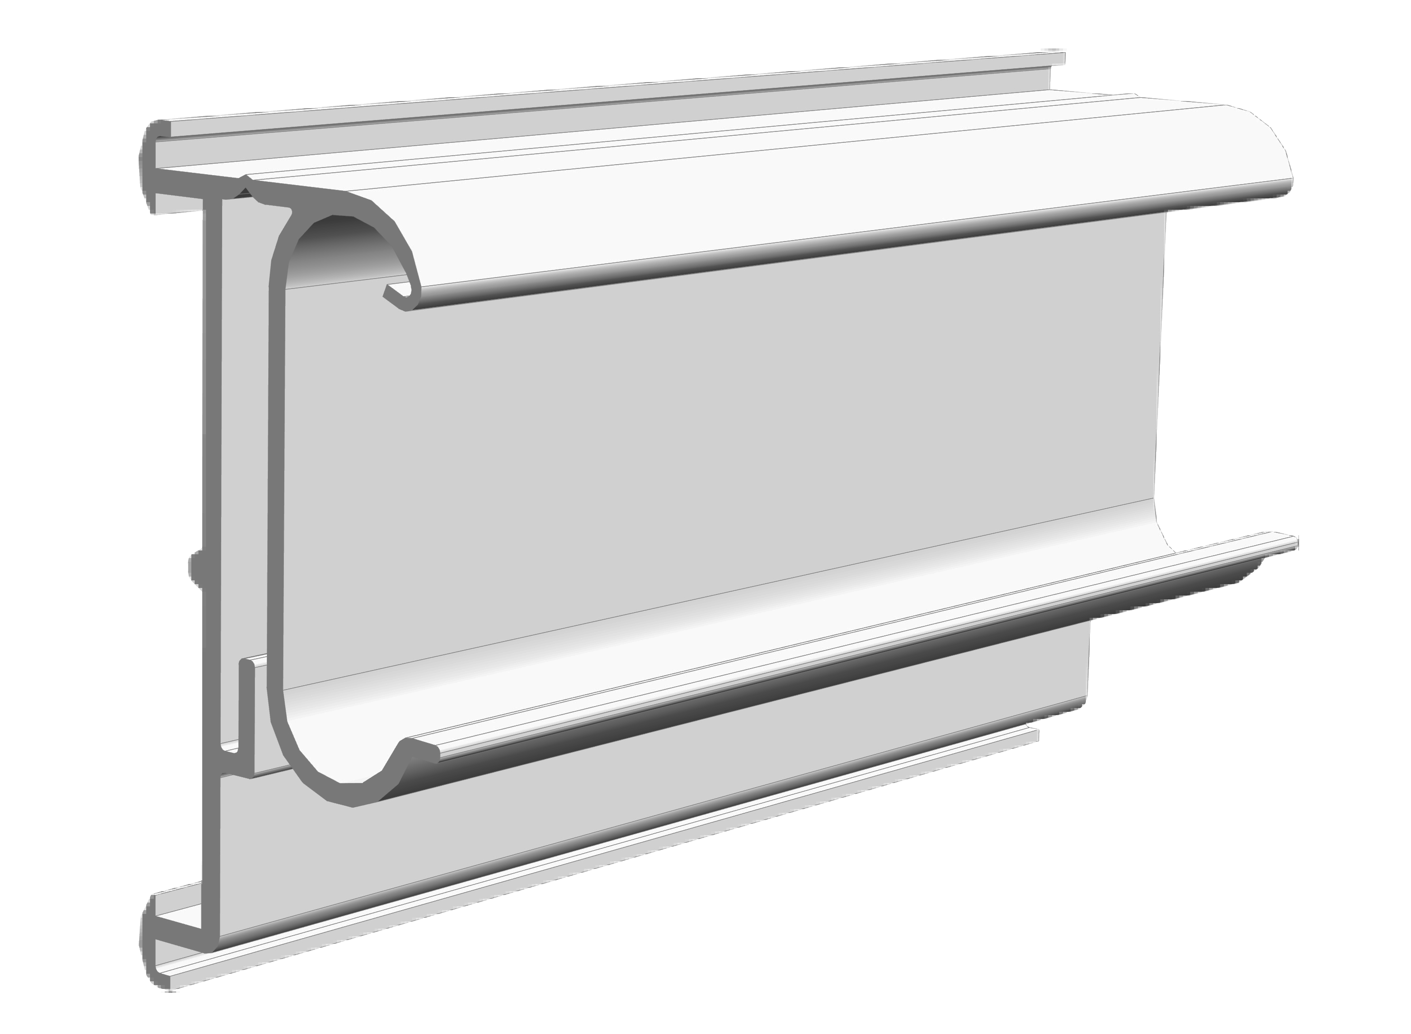
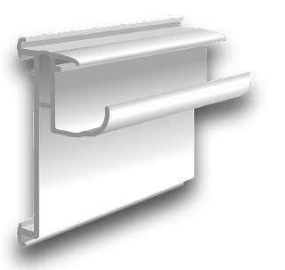
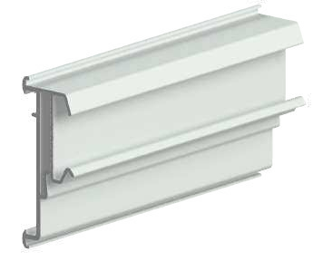
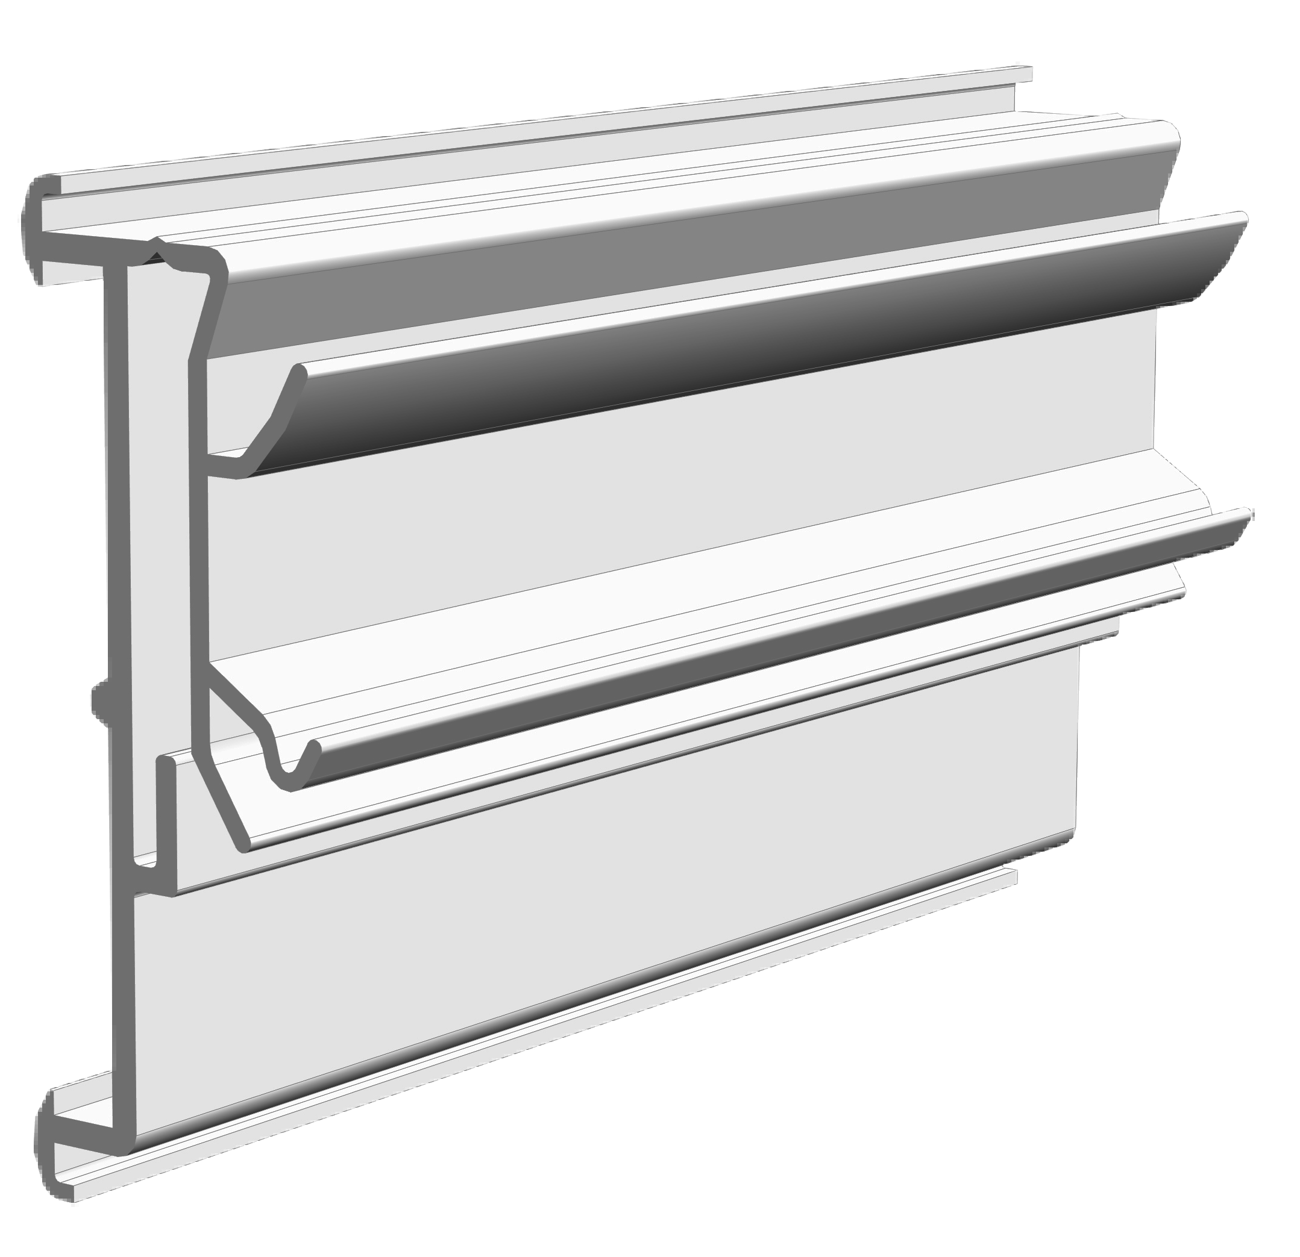
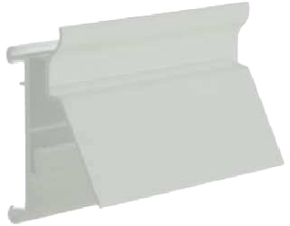

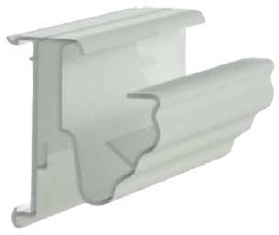
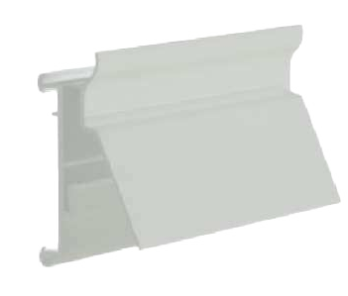

Profiles for electronic labels Solum / Catalogue 2023
PEE 1400
Profile for CEFLA SYSTEM 10 shelves. With hinge for oscilating function.
PEE 1350
Profile for BONNET NÈVÈ, ARNEG and LINDE / COSTAN fridge shelves. With hinge for oscilating function.
CODE COLOR
CODE
COLOR
PEE 1400-00 | TRANSPARENT
PEE 1400-05 | BLACK
PEE 1350-00 | TRANSPARENT
PEE 1350-05 | BLACK
SHELF SECTION
(Other Colors upon request)
SHELF SECTION
(Other Colors upon request)
CEFLA S. 10
Lenghts in stock: 985 & 1315 mm
(Other lenghts upon request)
Order quantity: Box of 50 pcs
BONET NÈVÈ LINDE / COSTAN
Lenghts in stock: 1235 mm
(Other lenghts upon request)
Order quantity: Box of 50 pcs
PEE 1425
Profile for WANZL shelves. With hinge for oscilating function.
CODE
COLOR
PEE 1318
Profile for AFS SYSTEM 20 shelves. With hinge for oscilating function.
PEE 1425-00 | TRANSPARENT
PEE 1425-05 | BLACK
CODE
COLOR
(Other Colors upon request)
PEE 1318-00 | TRANSPARENT
PEE 1318-05 | BLACK
SHELF SECTION
Individual sizes: 31mm (1.6”)
58mm (2.2”)
72mm (2.9”)
Order quantity: Box of 50 pcs
SHELF SECTION
(Other Colors upon request)
WANZL
AFS SYSTEM 20
Lenghts in stock: 985 & 1315 mm
(Other lenghts upon request)
Order quantity: Box of 50 pcs
PEE 1375
Profile for INTRAC IMZ25 shelves. With hinge for oscilating function.
PEE 1180
Profile for SIDAC. With hinge for oscilating function.
CODE
COLOR
CODE
COLOR
PEE 1375-00 | TRANSPARENT
PEE 1375-05 | BLACK
PEE 1180-00 | TRANSPARENT
PEE 1180-05 | BLACK
SHELF SECTION
(Other Colors upon request)
SHELF SECTION
(Other Colors upon request)
INTRAC IMZ25
Lenghts in stock: 985 & 1315 mm
(Other lenghts upon request)
Order quantity: Box of 50 pcs
SIDAC
Lenghts in stock: 985 & 1315 mm
(Other lenghts upon request)
Order quantity: Box of 40 pcs
PEE 1125
Profile double angle position for STOREBEST, TEGOMETALL and LINDE/COSTAN shelves.
With hinge for oscilating function.
CODE COLOR
PEE 1185
Profile for INTRAC - ARNEG AMX35. With hinge for oscilating function.
CODE
COLOR
PEE 1125-00 | TRANSPARENT
PEE 1125-05 | BLACK
SHELF SECTION
PEE 1185-00 | TRANSPARENT
PEE 1185-05 | BLACK
SHELF SECTION
(Other Colors upon request)
32
(Other Colors upon request)
STOREBEST TEGOMETALL LINDE / COSTAN
Lenghts in stock: 985 & 1315 mm
(Other lenghts upon request)
Order quantity: Box of 30 pcs
INTRAC - ARNEG AMX35
Lenghts in stock: 985 & 1315 mm
(Other lenghts upon request)
Order quantity: Box of 25 pcs
10
11

Slide 7
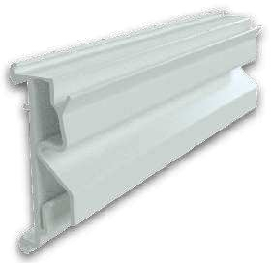
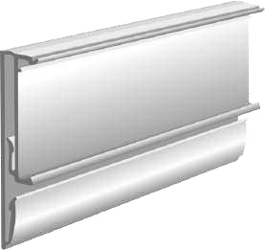
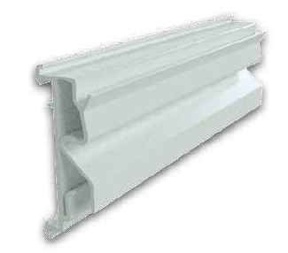
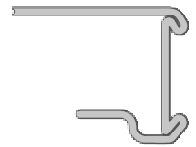
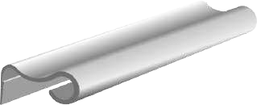
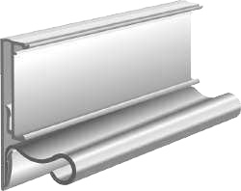
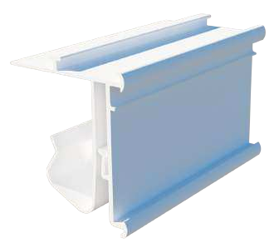
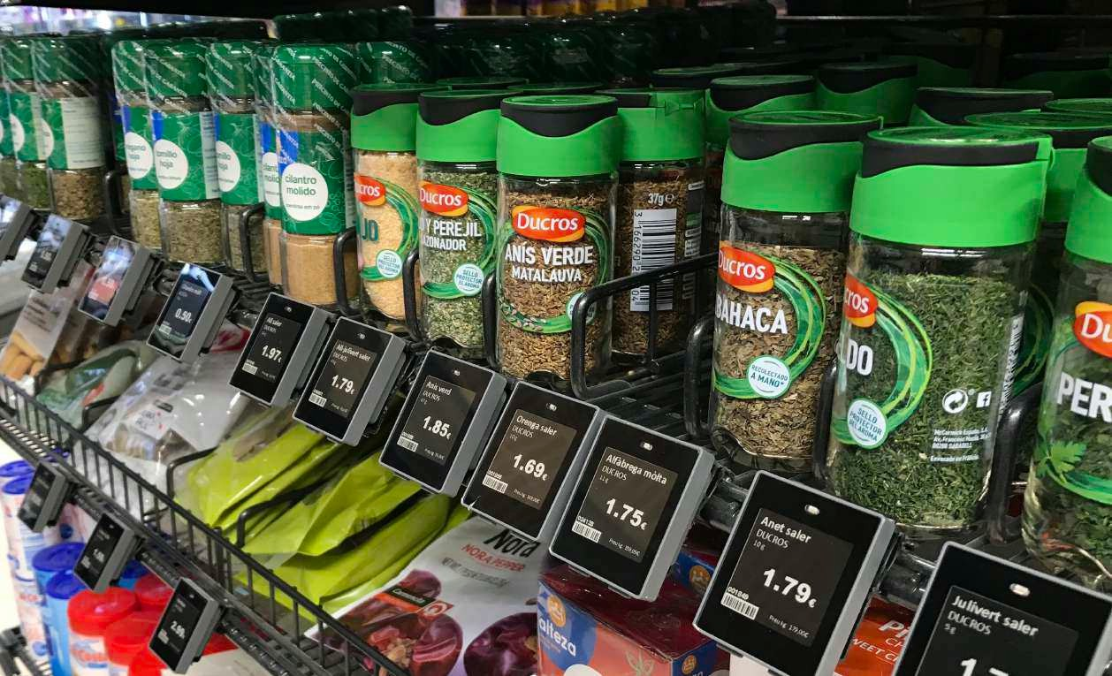

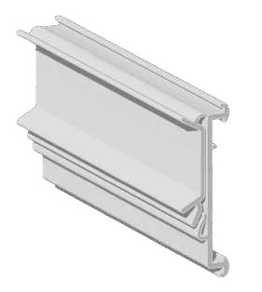
Profiles for electronic labels Solum / Catalogue 2023
PEE 1290
Profile for ARNEG OXACA. With hinge for oscilating function.
PEE 1370
Flat Bumper profile for flat shelves or surfaces. With hinge for oscilating function.
CODE
CODE
COLOR
COLOR
SHELF SECTION
PEE 1290-00 | TRANSPARENT
PEE 1290-05 | BLACK
PEE 1370-00 | TRANSPARENT
PEE 1370-05 | BLACK
(Other Colors upon request)
SHELF SECTION
(Other Colors upon request)
ARNEG OXACA
Lenghts in stock: 985 & 1315 mm
(Other lenghts upon request)
Order quantity: Box of 40 pcs
Lenghts in stock: 985 & 1315 mm
(Other lenghts upon request)
Order quantity: Box of 30 pcs
PEE 1295
Profile for ARNEG OXACA. With hinge for oscilating function.
CODE
COLOR
PEE 2300
Bumper accessory for flat bumper profile.
PEE 1295-00 | TRANSPARENT
PEE 1295-05 | BLACK
CODE
COLOR
SHELF SECTION
(Other Colors upon request)
PEE 2300-00 | TRANSPARENT
PEE 2300-05 | BLACK
Final profile
La Fortezza F25
Lenghts in stock: 985 & 1315 mm
(Other lenghts upon request)
Order quantity: Box of 40 pcs
(Other Colors upon request)
Lenghts in stock: 985 & 1315 mm
(Other lenghts upon request)
Order quantity: Box of 50 pcs
PEE 1430
Profile for ZAF. With hinge for oscilating function.
CODE
COLOR
PEE 1430-00 | TRANSPARENT
PEE 1430-05 | BLACK
SHELF SECTION
(Other Colors upon request)
Lenghts in stock: 985 & 1315 mm
(Other lenghts upon request)
ZAF (old version)
Order quantity: Box of 40 pcs
PEE 1380
Profile for INTRAC IMZ25 shelves. With hinge for oscilating function.
CODE
COLOR
PEE 1380-00 | TRANSPARENT
PEE 1380-05 | BLACK
SHELF SECTION
(Other Colors upon request)
Lenghts in stock: 985 & 1315 mm
(Other lenghts upon request)
Order quantity: Box of 30 pcs
INTRAC IMZ25
12
https://ovelar-retail.com 13

Slide 8
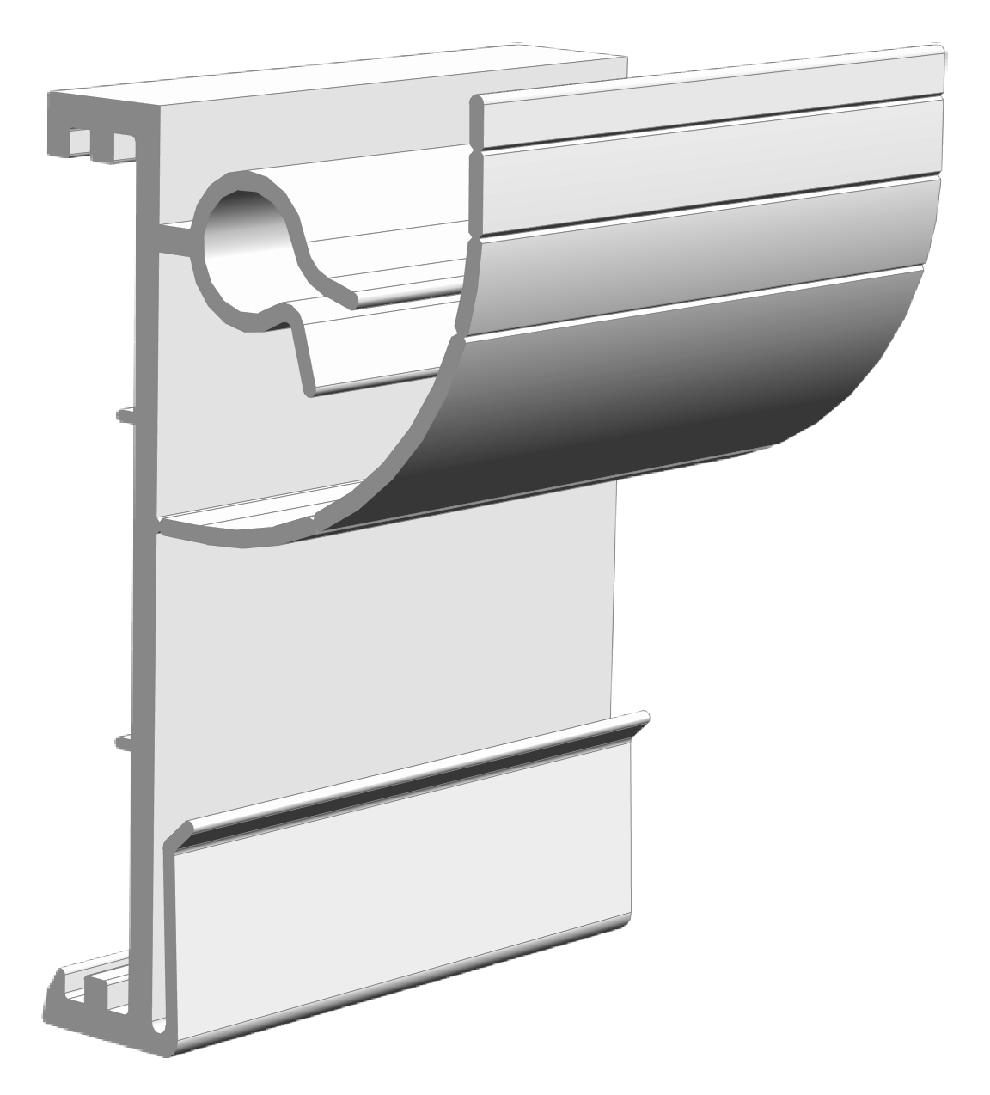




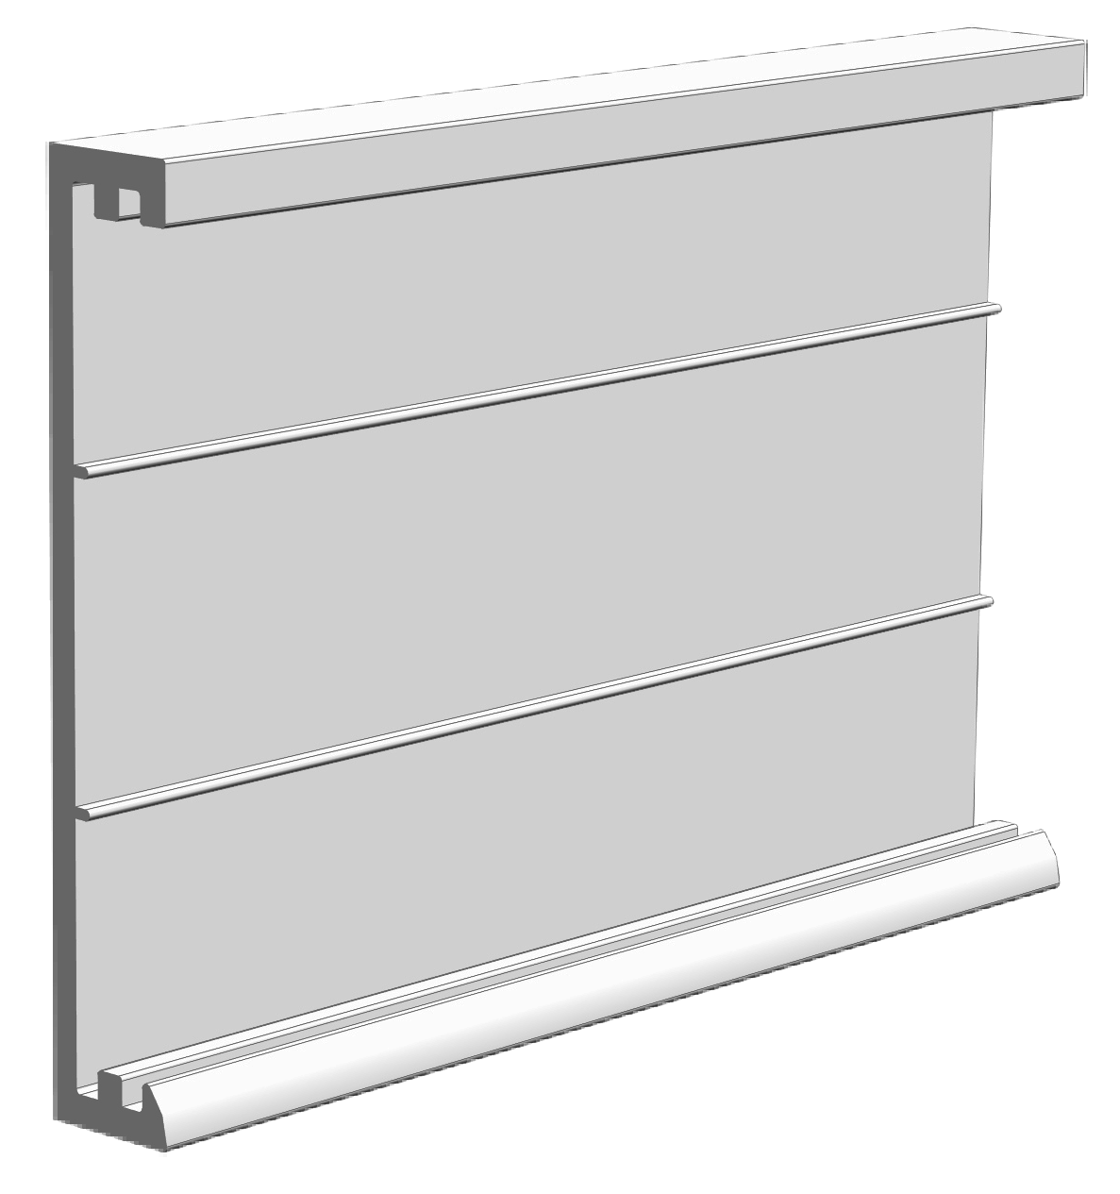
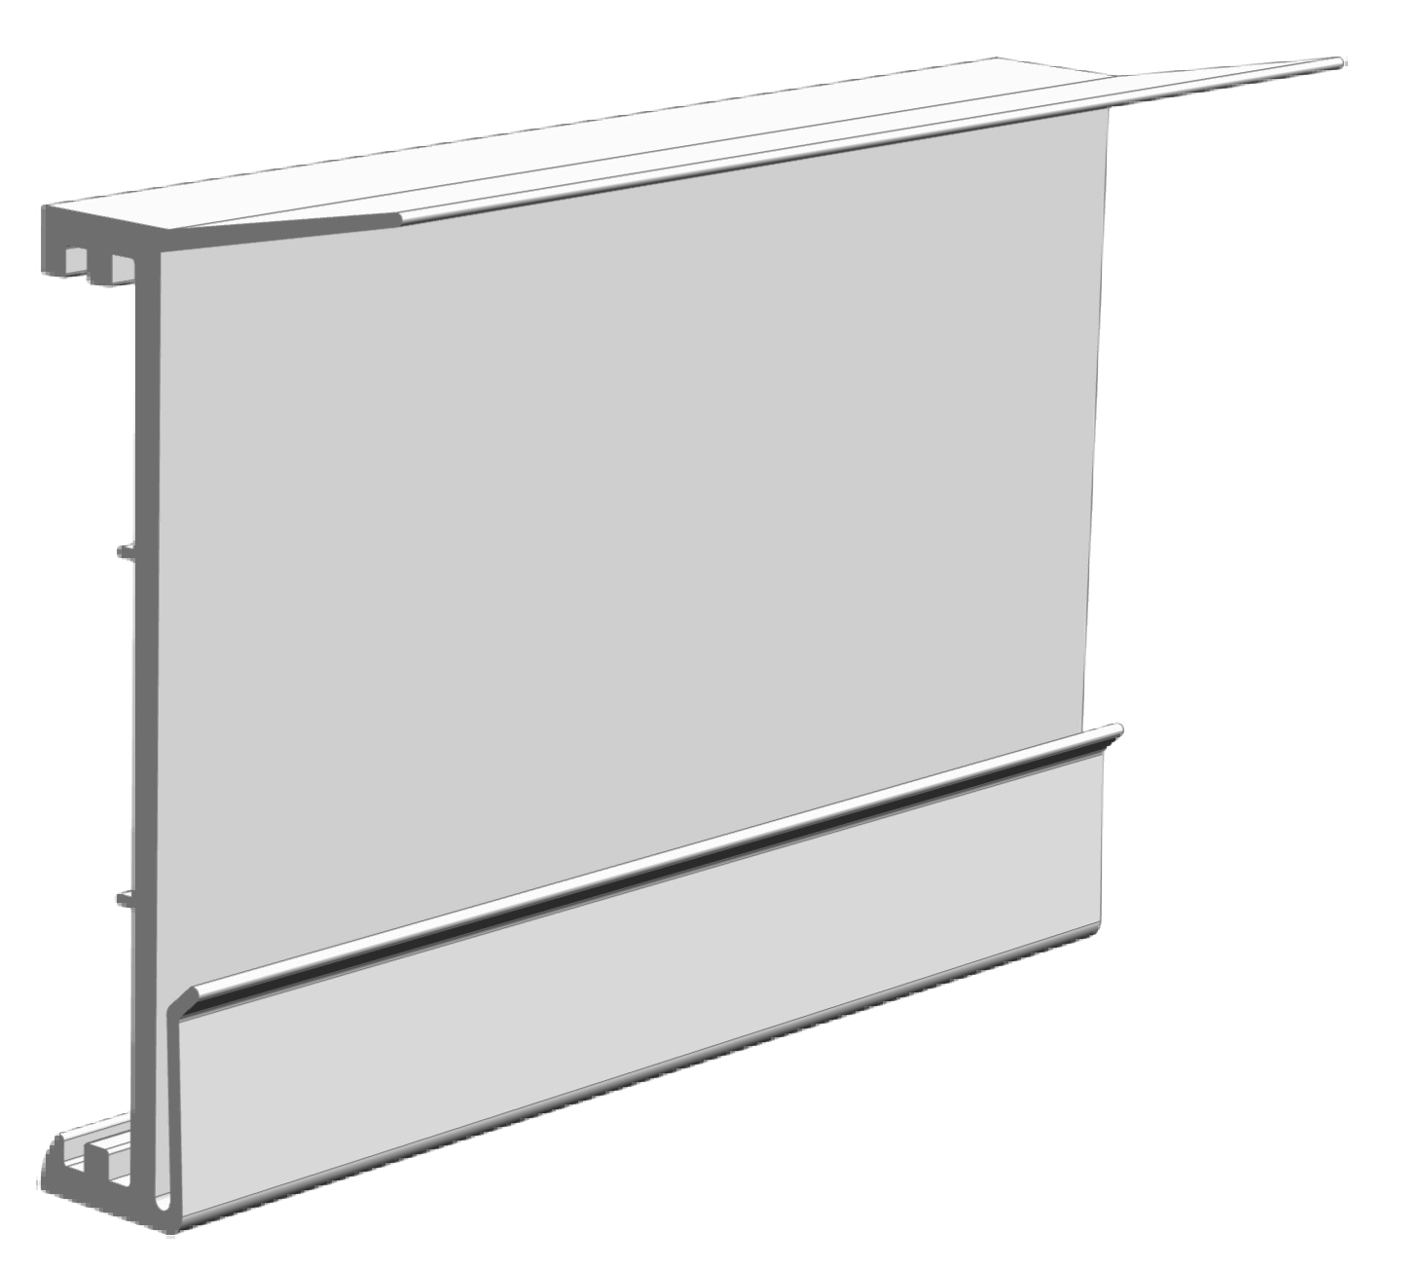
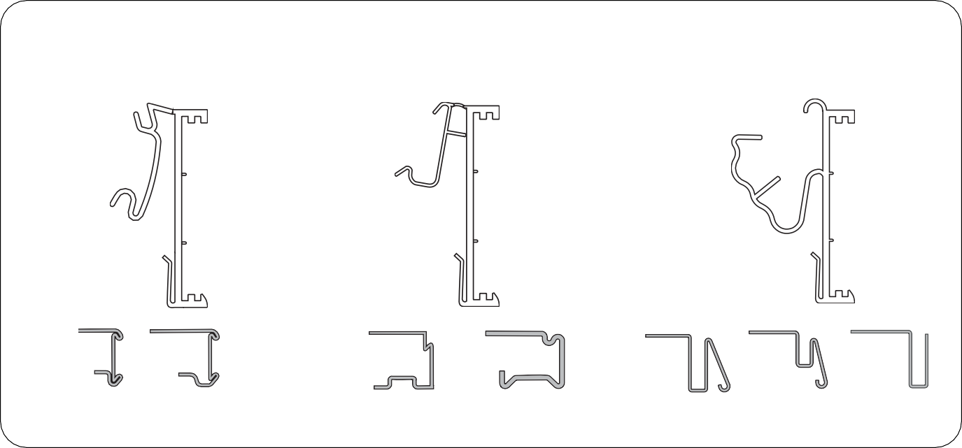
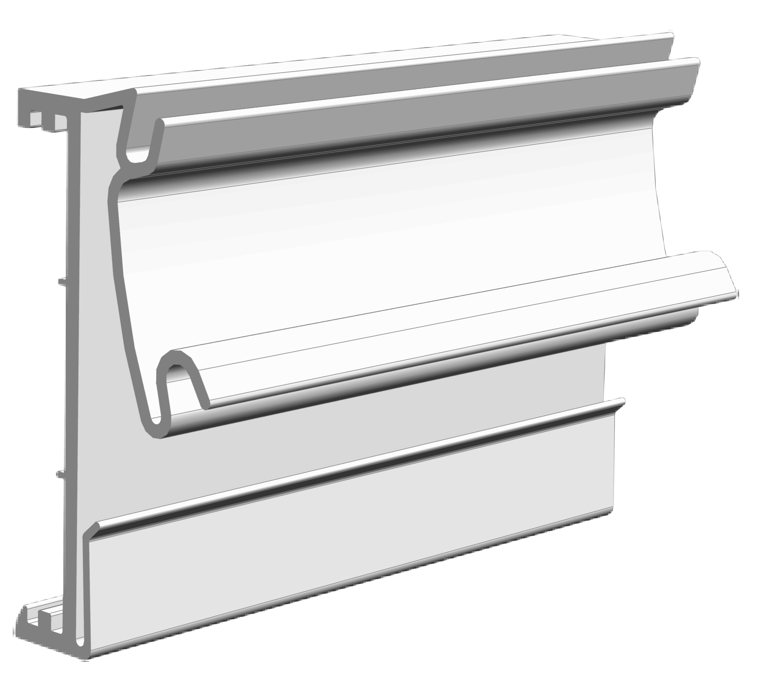
Profiles for electronic labels Solum / Catalogue 2023
Page 16
Profile for rods
PEE 2125
Bumper profile
PEE 2150
MAKRO/METRO
SERIES PROFILES
“T” rods
Impact protector profile for lower shelves.
Applicable to all types of shelves.
PEE 2000
Flat profiles for shelves or flat surfaces. With two 12 mm stickers.
CODE
COLOR
Page 15
PEE 2000-00 | TRANSPARENT
PEE 2000-05 | BLACK
Profile for commercial shelves
SHELF SECTION
(Other Colors upon request)
PEE 2000
PEE 2050
Lenghts in stock: 985 & 1315 mm
(Other lenghts upon request)
Order quantity: Box of 60 pcs
PEE 2050
Profile with adhesive and double flap.
CODE
COLOR
PEE 2050-00 | TRANSPARENT
PEE 2050-05 | BLACK
SHELF SECTION
(Other Colors upon request)
Lenghts in stock: 985 & 1315 mm
(Other lenghts upon request)
Order quantity: Box of 30 pcs
Page 15
Profile for commercial shelves
PEE 2075
PEE 2100
PEE 2025
PEE 2075
Profile for HMY P-25 & ALSER INNOVATION V4 shelves. With hinge for oscilating function.
CODE
COLOR
PEE 2075-00 | TRANSPARENT
PEE 2075-05 | BLACK
(Other Colors upon request)
HMY
ALSER INNOVATION V4
Lenghts in stock: 985 & 1315 mm
(Other lenghts upon request)
Order quantity: Box of 30 pcs
HMY
ALSER INNOVATION V4
CEFLA S25 MODERN EXPO KIDER KS
CAEM T25
STOREBEST
TEGOMETALL LINDE / COSTAN
14
15

Slide 9
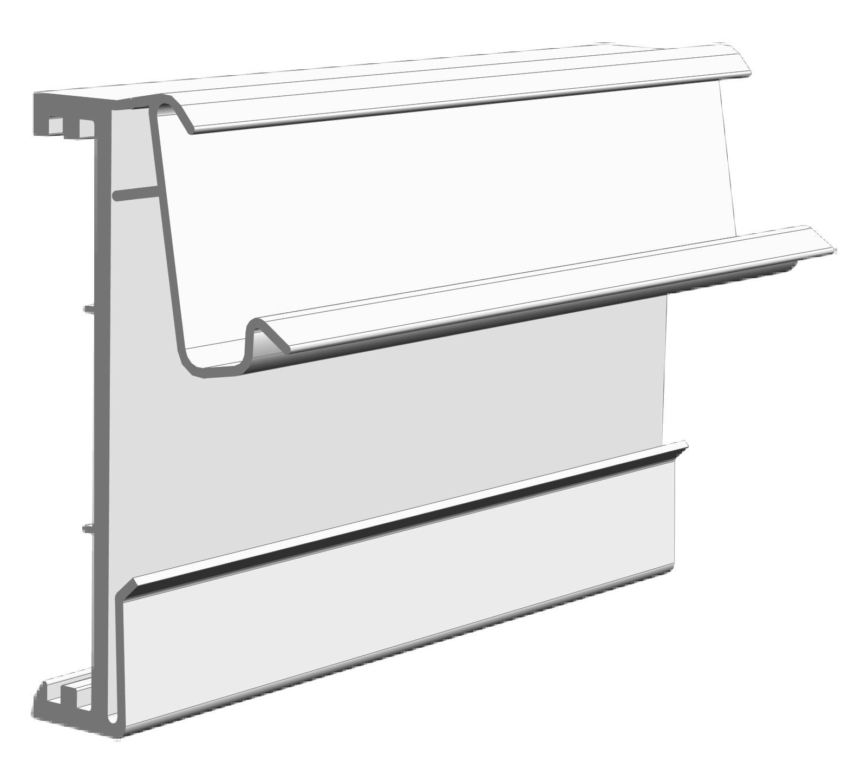
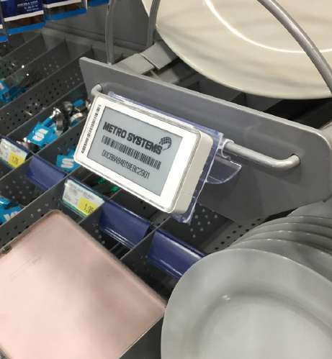
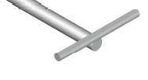









Profiles for electronic labels Solum / Catalogue 2023
PEE 2100
Profile for CEFLA SYSTEM 25, MODERN EXPO, KIDER KS & CAEM T25 shelves.
With hinge for oscilating function.
CODE
The profile for “T” hooks allows the labels to be placed on “T” hooks, adapting to them with the short rod in the upper, middle or lower position, as shown in the following infographic.
COLOR
SHELF SECTION
PEE 2100-00 | TRANSPARENT
PEE 2100-05 | BLACK
(Other Colors upon request)
Upper short rod
CEFLA S25 MODERN EXPO KIDER KS
CAEM T25
Lenghts in stock: 985 & 1315 mm
(Other lenghts upon request)
Order quantity: Box of 25 pcs
Middle short rod
PEE 2025
Profile double angle position for STOREBEST, TEGOMETALL & LINDE/COSTAN shelves.
CODE COLOR
Lower short rod
PEE 2025-00 | TRANSPARENT
PEE 2025-05 | BLACK
SHELF SECTION
(Other Colors upon request)
Lenghts in stock: 985, 1235 & 1315 mm
(Other lenghts upon request)
Order quantity: Box of 25 pcs
STOREBEST TEGOMETALL LINDE / COSTAN
PEE 2125
Profile for “T” rods. With various tilting positions.
CODE
COLOR
PEE 2125-00
TRANSPARENT
“T” RODS
(Other Colors upon request)
Lenghts in stock: 90 mm
(Other lenghts upon request)
Order quantity: Box of 250 pcs
PEE 2150
Profile Bumper rail. With anti-shock function for the bottom shelves.
CODE
COLOR
PEE 2150-00 | TRANSPARENT
PEE 2150-05 | BLACK
(Other Colors upon request)
Lenghts in stock: 985 & 1315 mm
(Other lenghts upon request)
Order quantity: Box of 30 pcs
16
https://ovelar-retail.com 17

Slide 10













ACCESORIES
FOR PROFILES
Profiles for electronic labels Solum / Catalogue 2023
PROMO
SYSTEM
PEE 1550
Accesory to adjust the profile angle on the shelf.
PROMOTIONAL TRANSPARENT FRONTAL POCKET
CODE
COLOR
Insert
PEE 1550-00
TRANSPARENT
COLOR
MATERIAL
Lenghts in stock: 60 mm
(Other lenghts upon request)
Order quantity: Box of 100 pcs
TRANSPARENT
PVC
Order quantity: Upon request
Applicable in profiles:
PEE 1150 / 1175 / 1200 / 1250 / 1275 / 1300 /
1325 / 1350 / 1375 / 1400 / 1450
Custom-made according to your needs.
OVA 09001-15
Electronic label remover tool. With this key you can easily remove labels from profiles.
CUSTOMIZABLE PROMOTIONAL STOPPER
CODE
MATERIAL
COLOR
MATERIAL
OVA 09001-15
ABS
CUSTOM
PVC
Order quantity: 1 pc
Order quantity: Upon request
Custom-made according to your needs.
OVA-03010-00
PERPENDICULAR STOPPER HOLDER CLAMP
OVA-03015-00
FRONT STOPPER HOLDER CLAMP
PROMOTIONAL TRANSPARENT POCKET
CODE
COLOR
MATERIAL
COLOR
MATERIAL
OVA-03010-00 | TRANSPARENT | POLYCARBONATE
OVA-03015-00 | TRANSPARENT | POLYCARBONATE
Insert
CUSTOM
PVC
Order quantity: Upon request
Order quantity: Box of 100 pcs
Applicable on all profiles except METRO / MAKRO series.
Custom-made according to your needs.
18
19

Slide 11











Profiles for electronic labels Solum / Catalogue 2023
PROMOTIONAL DISPLAY FOR ALL TYPES OF LABELS AND PROFILES
APPLICATION IN ALL SMALL SIZE SUPPORTS
COLOR
MATERIAL
CUSTOM
PVC
Order quantity: Upon request
Customizable dimensions Applicable in all profiles and availability in all
label sizes
We can produce
any promotional supplement in size, shape, colors and with adapted design to your bussines electronic labels.
Highlight your sales, promotions, product eatures and everythig you want to get your coustomer’s attention.
21

Slide 12





contact us
www.smartdigit.pt
info@smartdigit.pt
+351 211 165 222

